Slide 1
A New Emerging Pest in Florida: European Pepper Moth (EPM)

Slide 2
European pepper moth (EPM)
Native to parts of southern Europe, the eastern Mediterranean region, parts of northern Africa, and the Canary Islands
Expanded its range to include other parts of Africa, the Middle East, northwest India, Europe, Canada, and the United States
Detected in San Diego in 2004 and again in 2010
Detected in Florida in the fall of 2010
aka Southern European marshland pyralid
Notes:
Duponchelia fovealis (Zeller) (Lepidoptera: Crambidae) is a native to both freshwater and saltwater marshlands of southern Europe (mainland Spain, parts of France, and Portugal), the eastern Mediterranean region (Greece, Italy, Corsica, Macedonia (the original area that was part of the former Yugoslavia), Malta, Crete, Sardinia, Sicily), the Canary Islands, Syria, and Algeria.
However, it has expanded its range to include other parts of Africa and the Middle East, northwest India, Europe, Canada, and the United States. It was first reported outside of its native range in 1984 when it was found in Finland. It has since been detected in Belgium, the Czech Republic, Denmark, other parts of France, Germany, the Netherlands, Sweden, Hungary, the United Kingdom, and Canada. It has also been found in Cyprus and Gibraltar.
In the United States, it was detected on begonia in San Diego County in 2004 (though it was subsequently not detected in 2005). Then in April and July of 2010, the moth was detected again in San Diego County. As of September 2011, it has been detected in at least seventeen California counties, along with counties in Alabama, Arizona, Colorado, Florida, Georgia, Mississippi, New York, North Carolina, Oklahoma, Oregon, South Carolina, Tennessee, Texas, and Washington.
A Cooperative Agriculture Pest Survey Program (CAPS survey) was conducted in Florida from September 2010 to May 2011 to determine if EPM was present. The CAPS survey sampled 26 counties using 88 delta traps baited with a species specific. Adults (only) were detected in the following counties: Alachua, Bradford, Desoto, Duval, Charlotte, Collier, Hardee, Hernando, Highlands, Hillsborough, Manatee, Miami-Dade, Nassau, Palm Beach, Pinellas, Polk, Orange, Sarasota, Seminole, and Volusia.
It has been referred to by the common names southern European marshland pyralid (even though it has been moved from this family) and the European pepper moth (not to be confused by the European peppered moth).
This moth has become a notable greenhouse pest in northern Europe and Canada for the cut flower, vegetable, and aquatic plant industries. It has also become a pest of lisianthus and strawberries grown commercially in its native Italy. With several detections of this pest having now been made in the United States, researchers are monitoring for it to determine its distribution, whether or not it will become established in the landscape, and to see what damages it might have on our own greenhouse industry as well as to commercial crops grown outdoors or in shade houses. Based on the climate of its native habitat, this pest has a chance of becoming established in states along the west coast (California, Oregon, and Washington) as well as the southeastern U.S. (most of which have already reported detections of this moth).
Information sources:
Ahern, Robert. 2010. Amended NPAG Report. Duponchelia fovealis Zeller: Lepidoptera/Pyralidae.
Accessed 4/29/2011 -
http://entnemdept.ufl.edu/pestalert/NPAG_duponchelia_report.pdf .
Anonymous. 2005a. Risk management Decision Document for Duponchelia fovealis in Canada. Canadian Food Inspection Agency.
Accessed 4/29/2011 -
http://entnemdept.ufl.edu/pestalert/duponchelia_fovealis_risk_management.pdf
Anonymous. 2005b. Plant Pest Information: Duponchelia fovealis Zeller. Canadian Food Inspection Agency.
Accessed 4/29/2011 –
http://entnemdept.ufl.edu/pestalert/Duponchelia_fovealis_Canada.pdf
Bethke, James and Brian Vander Mey. 2010. Pest Alert: Duponchelia fovealis. University of California Cooperative Extension, San Diego.
Accessed 4/29/2011 –
http://cesandiego.ucdavis.edu/files/82188.pdf
Billen W, 1994. On the harmfulness of Duponchelia fovealis (Zeller, 1847) in Germany (Lepidoptera, Pyralidae). Nota Lepidopterol, 16: 3-4, p. 212.
Bonsignore, Carmelo Peter and Vincenzo Vacante. 2010. “Duponchelia fovealis (Zeller). A New Emergency for Strawberries?”. Protezione delle colture, pp. 40-43.
Brambila, Julieta and Ian Stocks. 2010. The European Pepper Moth, Duponchelia fovealis Zeller (Lepidoptera: Crambidae), a Mediterranean Pest Moth Discovered in Central Florida.
Accessed 4/29/2011 –
http://www.freshfromflorida.com/pi/pest_alerts/pdf/duponchelia_fovealis.pdf
CABI International. 2010. “Selected Sections for: Duponchelia fovealis (Southern European Marshland Pyralid)”. Crop Protection Compendium.
Derksen, A., and L. Whilby. 2011. “Update on Florida CAPS trapping activities for Duponchelia fovealis Zeller, September 2010 to May 2011”, CAPS Report.
accessed 8/15/2011 –
http://entomology.ifas.ufl.edu/stocks/DFOV_update%201_v5%2008-19-11.pdf
Faquaet, Marcel. 2000. “Duponchelia fovealis, een nieuwe soort voor de Belgische fauna (Lepidoptera: Pyralidae)”. Phegea 28:1.
Guda, C. D. , A. Capizzi, and P. Trematerra. 1988. “Damages on Eustoma grandiflorum (Raf.) Shinn. Caused by Duponchelia fovealis (Zeller)”. Annali dell’Istituto Sperimentale per la Floricultura. Vol. 19, pp. 3-11.
Hoffman, Kevin. 2010. CDFA Detection Advisory for a Cramid moth: Duponchelia fovealis (Zeller) (Pyraloidea: Crambidae). Reference PDR: 1511851.
Accessed 4/29/2011 –
http://www.kernag.com/dept/news/2010/2010-san-diego-duponchelia-fovealis-07-16-2010.pdf.
MacLeod, A. 1996. Summary Pest Risk Assessment: Duponchelia fovealis. DEFRA (Department for Environment, Food, and Rural Affairs), Central Science Laboratory, Sand Hutton, York, United Kingdom.
NAPPO – Phytosanitary alert system. 2010.
http://www.pestalert.org/oprDetail.cfm?oprID=466&keyword=Duponchelia%20fovealis

Slide 3
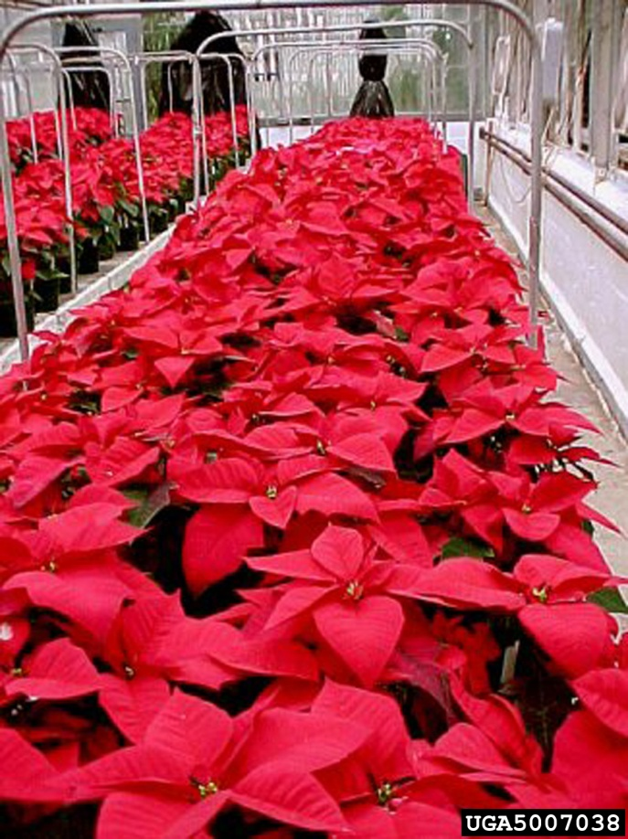
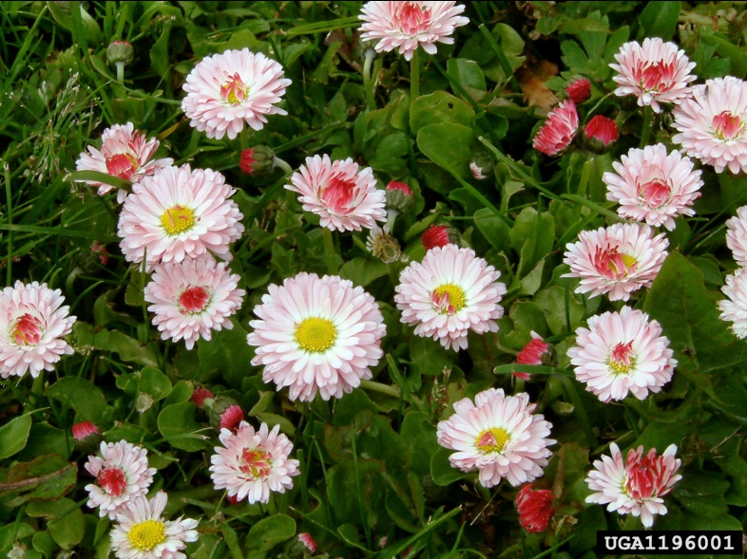
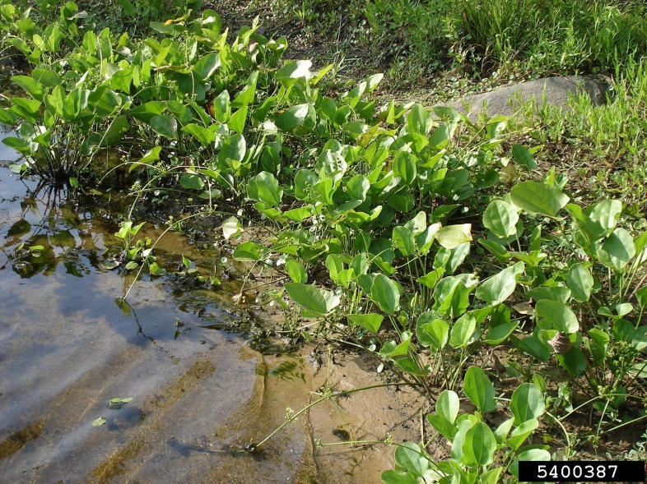
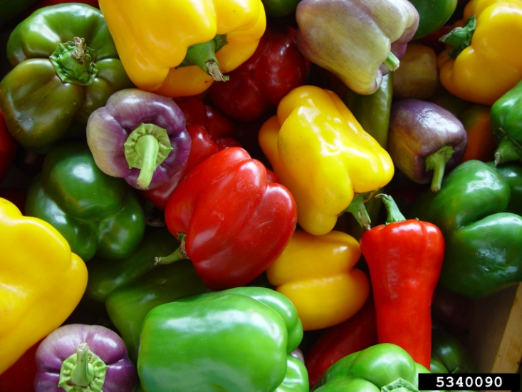
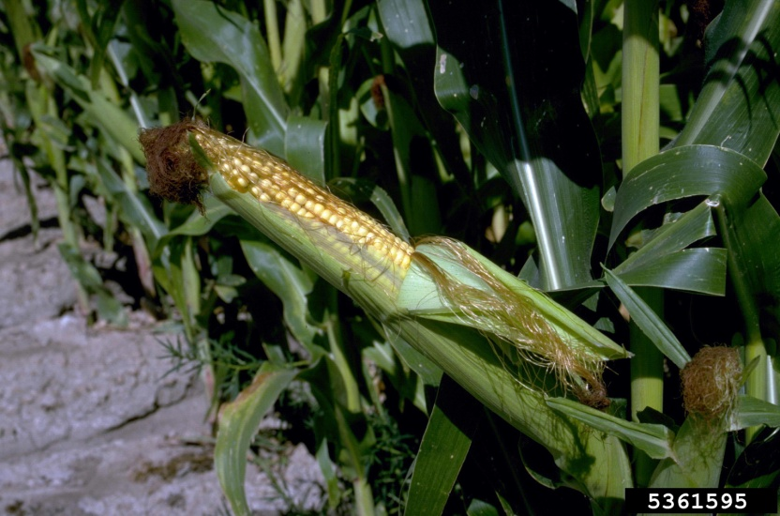
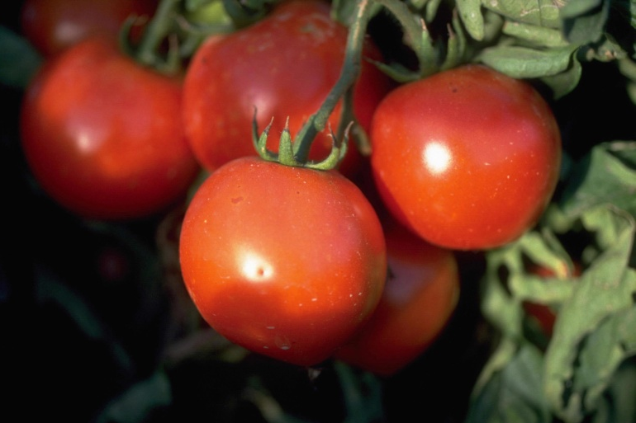
Pest of many herbaceous ornamentals and field crops
Image credits: Daisies - UAF Cooperative Extension Archive, University of Alaska – Fairbanks, www.bugwood.org, #1196001 ; sword plant - Graves Lovell, Alabama Department of Conservation and Natural Resources, www.bugwood.org, #5400387; poinsettias - Paul Thomas, University of Georgia, www.bugwood.org, #5007038; peppers - Gerald Holmes, Valent USA Corporation, www.bugwood.org, #5340090; corn - Howard F. Schwartz, Colorado State University, www.bugwood.org, #5361595; tomatoes - Howard F. Schwartz, Colorado State University, www.bugwood.org, #5365838.
Notes:
Duponchelia fovealis has been listed as a pest on at least 35 species of plants ranging from aquatic plants to crop plants to plants grown in the nursery and floriculture trade. They are:
Alternanthera splendida (aquatic plant)
Alternanthera rosaefolia (aquatic plant) Apium graveolens (celery)
Bacopa lanigera (water hyssop)
Begonia tuberosa
Begonia elatior
Bellis perennis (English daisy)
Beta vulgaris (beets)
Capsicum annuum (pepper)
Chenopodium album (lamb’s quarters)
Convolvulus arvensis (bindweed)
Cuphea hyssopifolia (false heather)
Echinodorus tropica (sword plant)
Echinodorus parviflorus (sword plant)
Euphorbia pulcherrima (poinsettia)
Eustoma grandiflorum (Lisianthus)
Ficus triangularis (fig)
Hyeronima alchorneoides (a tropical tree of South American origin so it is probably a transplanted landscape tree)
Hygrophila rubella (an aquatic plant)
Ludwigia glandulosa (aquatic plant)
Ludwigia perennis (aquatic plant)
Malva sylvestris (mallow)
Mentha pulegium (penny royal)
Nesaea pedicellata (an aquatic plant)
Ocimum basilicum (basil)
Origanum majorana (majorum)
Oxalis acetosella (common wood sorrel)
Plantago lanceolata (plantain)
Portulaca oleracea (common purslane)
Punica granatum (pomegranate)
Ranunculus repens (creeping buttercup)
Rotala macranda (an aquatic plant)
Rotala wallichii (an aquatic plant)
Rubus fruticosus (blackberry)
Solanum lycopersicum (tomatoes)
Additionally, damage notes in the literature include the following genera:
Amaranthus, Anemone, Annona, Anthurium, Bouvardia, Calathea, Chrysanthemum, Cineraria, Codiaeum, Coleus, Cucumis (cucumbers), Cucurbita (squash), Cyclamen, Fragaria (strawberries), Gerbera (African daisies), Heuchera (coral bells), Impatiens, Kalanchoe, Lactuca (lettuce), Limonium (sea lavender), Lysimachia, Ophiopogon (mondo grass), Pelargonium (geranium), Paeonia, Phalaenopsis (orchids), Rhododendron (azalea), Rosa (roses), Rumex, Sambucus (elderberry), Sarracenia, Senecio, Tanacetum, Thymus (thyme), Ulmus (elm), Zea (corn). They also attack certain aquatic plants such as Aponogeton and Cryptocoryne.
In fact, its natural habitat is freshwater and saltwater marshlands, so ornamental aquatic plants (especially if grown in a greenhouse setting) are particularly susceptible. As it is mainly a threat to cultivated crops, it does not seem to represent a threat to biodiversity and natural ecosystems; however, it is prudent to remember that not much is known about its ecology in its native habitat (including what plants its feeds on in the marshlands). Therefore, there is potential for it being an environmental threat.
Virtually all of the plants listed above either are or can be grown in Florida, many of them commercially and most of them can be maintained in a homeowner’s yard. Florida’s crop plants that are probably the most at risk from this pest include: green peppers (which generated $198,553,000 in sales in 2009), cucumbers (which generated $101,550,000 in sales in 2009), squash (which generated $51,480,000 in sales in 2009), tomatoes (which generated $520,205,000 in sales in 2009), strawberries (which generated $313,632,000 in sales in 2009), and corn which generated ($227,154,000 in sales in 2009).
Information sources:
Ahern, Robert. 2010. Amended NPAG Report. Duponchelia fovealis Zeller: Lepidoptera/Pyralidae. Accessed 4/29/2011 -
http://entnemdept.ufl.edu/pestalert/NPAG_duponchelia_report.pdf .
Anonymous. 2005a. Risk management Decision Document for Duponchelia fovealis in Canada. Canadian Food Inspection Agency.
Accessed 4/29/2011 -
http://entnemdept.ufl.edu/pestalert/duponchelia_fovealis_risk_management.pdf
Bethke, James and Brian Vander Mey. 2010. Pest Alert: Duponchelia fovealis. University of California Cooperative Extension, San Diego.
Accessed 4/29/2011 –
http://cesandiego.ucdavis.edu/files/82188.pdf
Billen W, 1994. On the harmfulness of Duponchelia fovealis (Zeller, 1847) in Germany (Lepidoptera, Pyralidae). Nota Lepidopterol, 16: 3-4, p. 212.
Bonsignore, Carmelo Peter and Vincenzo Vacante. 2010. “Duponchelia fovealis (Zeller). A New Emergency for Strawberries?”. Protezione delle colture, pp. 40-43.
Brambila, Julieta and Ian Stocks. 2010. The European Pepper Moth, Duponchelia fovealis Zeller (Lepidoptera: Crambidae), a Mediterranean Pest Moth Discovered in Central Florida.
Accessed 4/29/2011 -
http://www.freshfromflorida.com/pi/pest_alerts/pdf/duponchelia_fovealis.pdf
CABI International. 2010. “Selected Sections for: Duponchelia fovealis (Southern European Marshland Pyralid)”. Crop Protection Compendium.
Clark, J. S. 2000. Duponchelia fovealis (Zell.) arriving on imported plant material. Atropos 10:20–21.
DeVenter, Peter van. 2009. “Water trap best for catching Duponchelia”. Fruit & Veg Tech 9.1.
Accessed 4/29/2011 -
http://documents.plant.wur.nl/wurglas/C_bestwatertrap.pdf.
Guda, C. D. , A. Capizzi, and P. Trematerra. 1988. “Damages on Eustoma grandiflorum (Raf.) Shinn. Caused by Duponchelia fovealis (Zeller)”. Annali dell’Istituto Sperimentale per la Floricultura. Vol. 19, pp. 3-11.
Hoffman, Kevin. 2010. CDFA Detection Advisory for a Cramid moth: Duponchelia fovealis (Zeller) (Pyraloidea: Crambidae). Reference PDR: 1511851.
Accessed 4/29/2011 –
http://www.kernag.com/dept/news/2010/2010-san-diego-duponchelia-fovealis-07-16-2010.pdf.
MacLeod, A. 1996. Summary Pest Risk Assessment: Duponchelia fovealis. DEFRA (Department for Environment, Food, and Rural Affairs), Central Science Laboratory, Sand Hutton, York, United Kingdom.
Marek J. and E. Bártová. 1998. Duponchelia fovealis Zeller, 1847, a new pest of glasshouse plants in the Czech Republic. Plant Protection Science, 34(4):151-152.
Romeijn, G. 1996. “Een nieuwe plaag in de kas”, Vakblad voor de Bloemisterij, volume 47, pp. 46-47.
Unknown. 2006a. “Duponchelia alla ribalta”, Colture Protette, No. 3, page 14.
Zimmermann, Olaf. 2004. “Use of Trichogramma wasps in Germany; Present Status of Research and Commercial Application of Egg Parasitoids Against Lepidopterous Pests for Crop” Gesunde Pflanzen 56 (6), pp. 157-166.
Monetary data obtained from USDA ERS for the state of Florida.

Slide 4
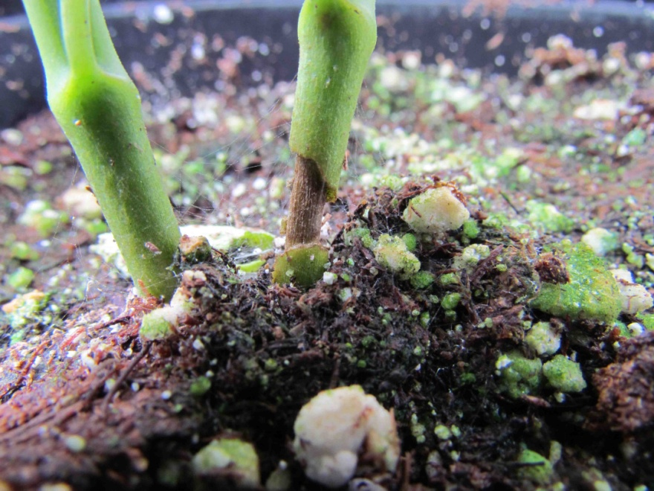
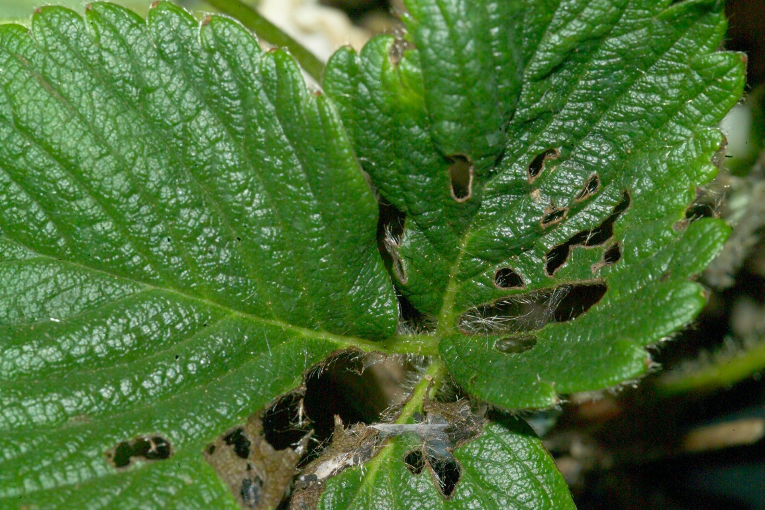
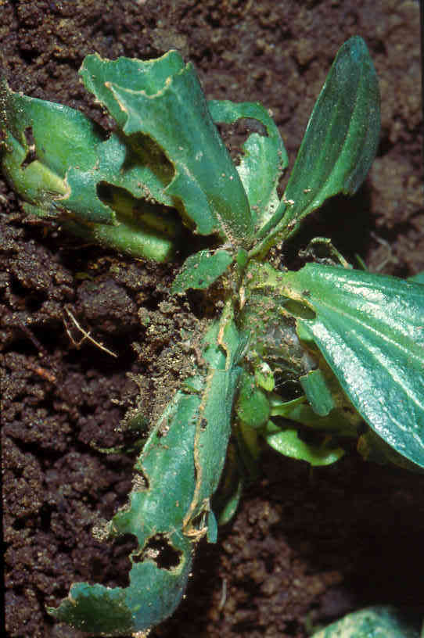
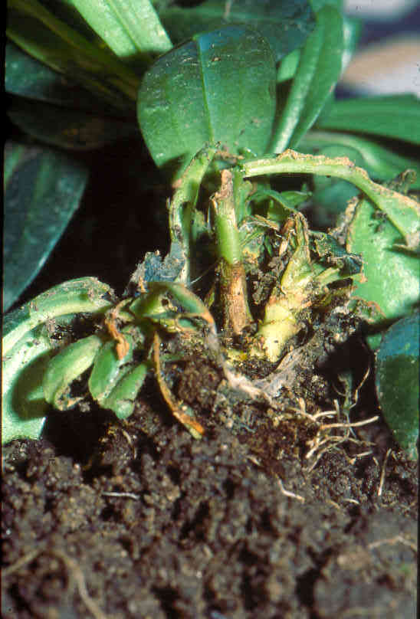
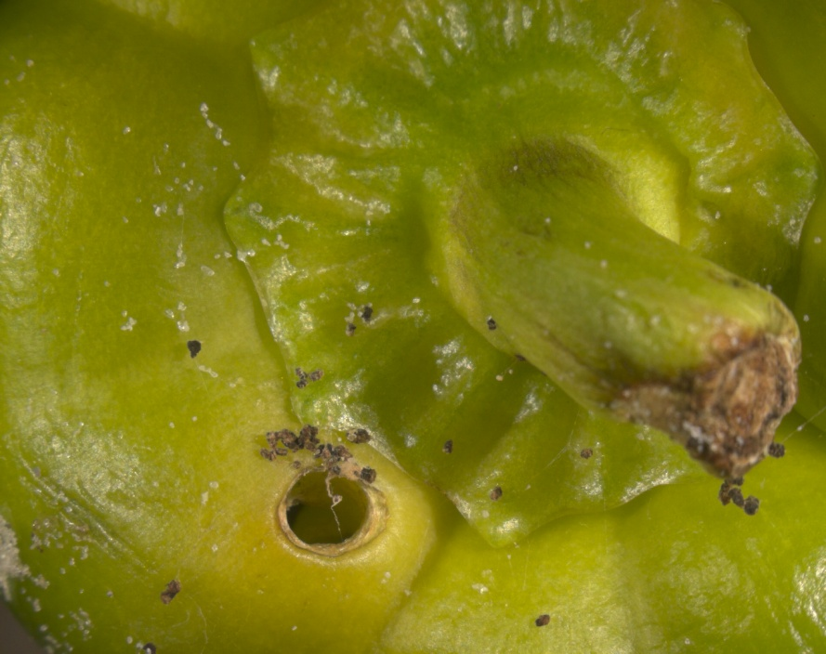
Damage
Image credits:
Top left - Carmelo Peter Bonsignore, Università degli Studi Mediterranei di Reggio Calabria
Bottom left - Marja van der Straten, Plant Protection Service, Wageningen, The Netherlands
Top right - Bryan Vander Mey, Department of Entomology, University of California, Riverside
Bottom right - Henk Stigter, Plant Protection Service, National Reference Centre, The Netherlands
Notes:
EPM inflicts damage to roots, leaves, flowers, buds, and fruit on which it feeds as larvae. In leaves, this feeding damage appears first as rounded or crescent-shaped bites on the outside of the leaves, but eventually the whole leaf is eaten. The leaves that are attacked are usually at the base of the plant but leaves higher in the canopy can also be attacked if the plants are placed very close together.
Late instar larvae can even burrow into soft woody or herbaceous plant stems causing more damage (i.e. withered or dried crowns and stem collapse). In the report from Billen, the larvae hatched from eggs laid in the top of the poinsettia plants then bored into the main stem eating their way down to the plant base causing collapse of the plant stem. In another report from Guda et al., on damage to Eustoma grandiflorum (lisianthus), the holes left by the boring of this pest into the stem facilitated infection by the fungus Botrytis cinerea. Lastly, a report from Romeijn states that in woody plants, the caterpillars are seen higher up in the plant within its webbing and in gerbers, the caterpillar was found between the petals.
In potted plants where the soil is not hard packed around the roots, the larvae can be found below the soil line sometimes feeding on roots. They also feed on decaying plant debris. According to several reports, while there is no feeding damage to live roses, high numbers of larvae can be found in rose detritus which could serve as a source of infestation for other plants.
Sometimes, EPM eats so aggressively that only the naked caules (stem or stalk of the plant) are left. Other times, external damage can only be detected when there are heavy infestations due to the fact that it can bore into the stems. The leaves can appear to develop normally and the grower does not know he has the pest until the damage is already done. The stems will collapse suddenly without the darkening of the stem associated with fungal diseases.
Images above show damage to fruit such as peppers (orange arrow), leaves such as on this Eustoma (white arrows) and a strawberry plant (pink arrows), and stem (yellow and black arrows).
Information sources:
Ahern, Robert. 2010. Amended NPAG Report. Duponchelia fovealis Zeller: Lepidoptera/Pyralidae.
Accessed 4/29/2011 -
http://entnemdept.ufl.edu/pestalert/NPAG_duponchelia_report.pdf .
Anonymous. 2005a. Risk management Decision Document for Duponchelia fovealis in Canada. Canadian Food Inspection Agency.
Accessed 4/29/2011 -
http://entnemdept.ufl.edu/pestalert/duponchelia_fovealis_risk_management.pdf
Anonymous. 2005b. Plant Pest Information: Duponchelia fovealis Zeller. Canadian Food Inspection Agency.
Accessed 4/29/2011 –
http://entnemdept.ufl.edu/pestalert/Duponchelia_fovealis_Canada.pdf
Bethke, James and Brian Vander Mey. 2010. Pest Alert: Duponchelia fovealis. University of California Cooperative Extension, San Diego.
Accessed 4/29/2011 –
http://cesandiego.ucdavis.edu/files/82188.pdf
Billen W, 1994. On the harmfulness of Duponchelia fovealis (Zeller, 1847) in Germany (Lepidoptera, Pyralidae). Nota Lepidopterol, 16: 3-4, p. 212.
Bonsignore, Carmelo Peter and Vincenzo Vacante. 2010. “Duponchelia fovealis (Zeller). A New Emergency for Strawberries?”. Protezione delle colture, pp. 40-43.
Brambila, Julieta and Ian Stocks. 2010. The European Pepper Moth, Duponchelia fovealis Zeller (Lepidoptera: Crambidae), a Mediterranean Pest Moth Discovered in Central Florida.
Accessed 4/29/2011 -
http://www.freshfromflorida.com/pi/pest_alerts/pdf/duponchelia_fovealis.pdf
CABI International. 2010. “Selected Sections for: Duponchelia fovealis (Southern European Marshland Pyralid)”. Crop Protection Compendium.
Guda, C. D. , A. Capizzi, and P. Trematerra. 1988. “Damages on Eustoma grandiflorum (Raf.) Shinn. Caused by Duponchelia fovealis (Zeller)”. Annali dell’Istituto Sperimentale per la Floricultura. Vol. 19, pp. 3-11.
Hoffman, Kevin. 2010. CDFA Detection Advisory for a Cramid moth: Duponchelia fovealis (Zeller) (Pyraloidea: Crambidae). Reference PDR: 1511851.
Accessed 4/29/2011 –
http://www.kernag.com/dept/news/2010/2010-san-diego-duponchelia-fovealis-07-16-2010.pdf.
Marek J. and E. Bártová. 1998. Duponchelia fovealis Zeller, 1847, a new pest of glasshouse plants in the Czech Republic. Plant Protection Science, 34(4):151-152.
MacLeod, A. 1996. Summary Pest Risk Assessment: Duponchelia fovealis. DEFRA (Department for Environment, Food, and Rural Affairs), Central Science Laboratory, Sand Hutton, York, United Kingdom.
Messelink, G. and W. Van Wensveen. 2003. “Biocontrol of Duponchelia fovealis (Lepidoptera: Pyralidae) with Soil-Dwelling Predators in Potted Plants”. Communications in Agriculture and Applied Biological Sciences, Ghent University, 68(4a), pp. 159-165.
Murphy, Graeme. 2005. Duponchelia fovealis - pronouncing it is just the start of the battle
Accessed 4-29-2011 -
http://www.omafra.gov.on.ca/english/crops/hort/news/grower/2005/08gn05a1.htm
Pijnakker, Juliette. 2001. “Duponchelia fovealis, le lépidoptère redouté des plantes en pot aux Pays-Bas”, Revue Horticole, volume 429, pp. 51-53.
Romeijn, G. 1996. “Een nieuwe plaag in de kas”, Vakblad voor de Bloemisterij, volume 47, pp. 46-47.
Unknown. 2006a. “Duponchelia alla ribalta”, Colture Protette, No. 3, page 14.

Slide 5
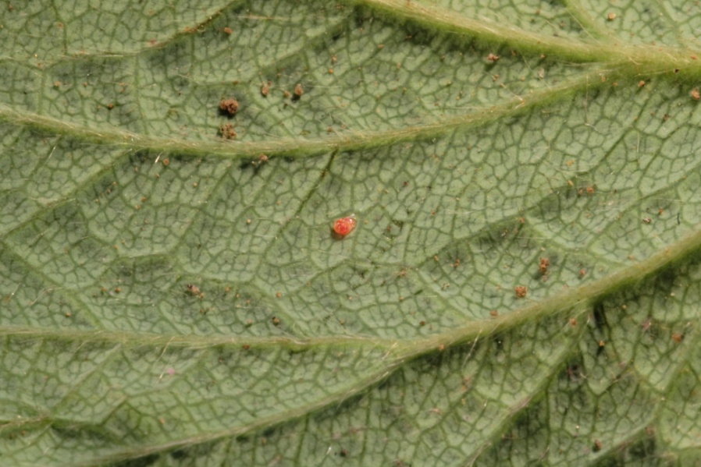
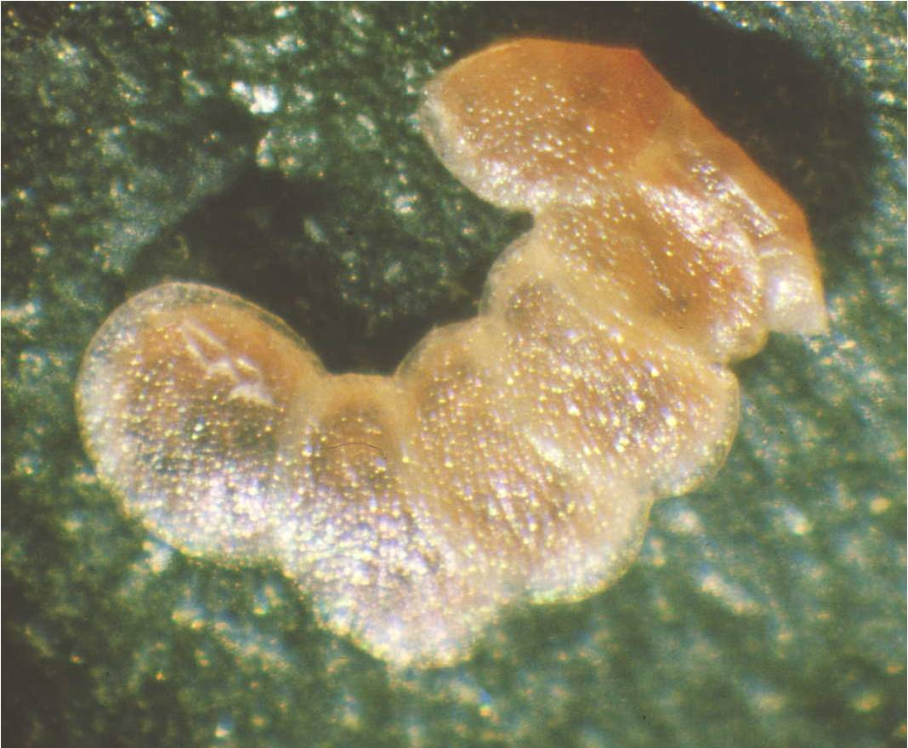
Identification
Eggs
0.5mm by 0.7mm
Whitish green turning pink, then red, then brown as the egg gets closer to hatching
Laid singly or in groups of 3-10
Overlapping like tiles
Mostly found on undersides of leaves, on the stems, at the base of the plant, in the upper soil layer
Image credits:
upper images- Carmelo Peter Bonsignore, Università degli Studi Mediterranei di Reggio Calabria
middle image – Lance Osborne, Mid-Florida Research and Education Center, University of Florida
bottom image - Pasquale Trematerra, University of Molise, Italy.
Notes:
The eggs measure 0.5 X 0.7mm (0.02 X 0.03inches) and are whitish green or straw colored when laid. Eggs turn pink then red as the embryo develops, finally turning brown prior to hatching. They are laid singly or in masses of 3-10 (overlapping like roofing tile) mostly on the undersides of leaves (close to the veins) though they can also be found on the upper surface of the leaf, on the stalks, at the base of the plant, or in the upper soil layer.
Females have also been documented to lay eggs on furnishings within the greenhouse. In addition, Lance Osborne (Mid-Florida Research and Education Center– Apopka) has recorded eggs being laid on the fruit.
Information sources:
Anonymous. 2005a. Risk management Decision Document for Duponchelia fovealis in Canada. Canadian Food Inspection Agency.
Accessed 4/29/2011 -
http://entnemdept.ufl.edu/pestalert/duponchelia_fovealis_risk_management.pdf
Anonymous. 2005b. Plant Pest Information: Duponchelia fovealis Zeller. Canadian Food Inspection Agency.
Accessed 4/29/2011 –
http://entnemdept.ufl.edu/pestalert/Duponchelia_fovealis_Canada.pdf
Bethke, James and Brian Vander Mey. 2010. Pest Alert: Duponchelia fovealis. University of California Cooperative Extension, San Diego.
Accessed 4/29/2011 –
http://cesandiego.ucdavis.edu/files/82188.pdf
Billen W, 1994. On the harmfulness of Duponchelia fovealis (Zeller, 1847) in Germany (Lepidoptera, Pyralidae). Nota Lepidopterol, 16: 3-4, p. 212.
Bonsignore, Carmelo Peter and Vincenzo Vacante. 2010. “Duponchelia fovealis (Zeller). A New Emergency for Strawberries?”. Protezione delle colture, pp. 40-43.
Brambila, Julieta and Ian Stocks. 2010. The European Pepper Moth, Duponchelia fovealis Zeller (Lepidoptera: Crambidae), a Mediterranean Pest Moth Discovered in Central Florida.
Accessed 4/29/2011 -
http://www.freshfromflorida.com/pi/pest_alerts/pdf/duponchelia_fovealis.pdf
CABI International. 2010. “Selected Sections for: Duponchelia fovealis (Southern European Marshland Pyralid)”. Crop Protection Compendium.
Guda, C. D. , A. Capizzi, and P. Trematerra. 1988. “Damages on Eustoma grandiflorum (Raf.) Shinn. Caused by Duponchelia fovealis (Zeller)”. Annali dell’Istituto Sperimentale per la Floricultura. Vol. 19, pp. 3-11.
Hoffman, Kevin. 2010. CDFA Detection Advisory for a Cramid moth: Duponchelia fovealis (Zeller) (Pyraloidea: Crambidae). Reference PDR: 1511851.
Accessed 4/29/2011 –
http://www.kernag.com/dept/news/2010/2010-san-diego-duponchelia-fovealis-07-16-2010.pdf.
Jackel, Barbara, Birgit Kummer, and Monika Kurhais. 1996. “Biological Control of Duponchelia fovealis Zeller (Lepidoptera, Pyralidae)”. Mitteilungen aus der Biologishen fur Land und Forstwirtschaft. Vol. 321. p. 483.
Trematerra, P. 1990. “Morphological aspects of Duponchelia fovealis Zeller (Lepidoptera: Pyralidae)”. Redia, vol. 73, issue 1, pp. 41-52.

Slide 6
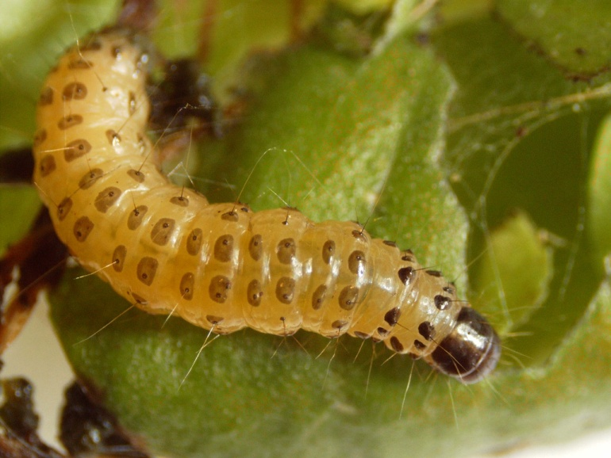
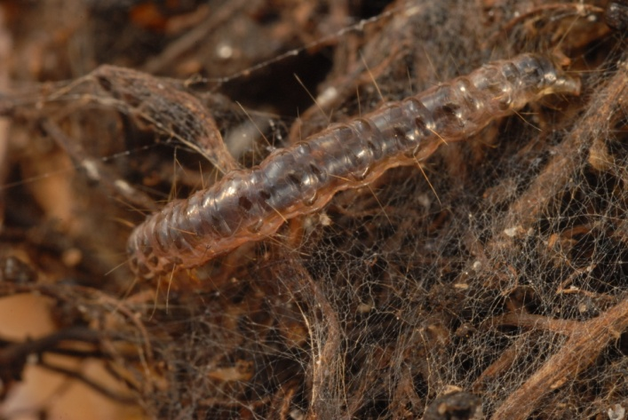
Identification
Larvae
1.5mm at hatching
Pink body with dark brown to gray spots and dark head
Turn creamy white or light brown with spots as they mature
Color depends on host plant
20-30mm long when fully developed
Image credits:
Top – Henk Stigter, Plant Protection Service, National Reference Centre, The Netherlands
Two middle images - Marja van der Straten, Plant Protection Service, Wageningen, The Netherlands
Bottom - Lyle Buss, Department of Entomology and Nematology, University of Florida
Notes:
Upon hatching, the larvae measure 1.5mm (0.06in) in length and have a shiny dark head and a salmon pink body with a line of separated brown to gray spots extending across and around each segment. On some segments, there are 2 transverse rows of these spots. The second row of spots will not extend around the segment; they stop on the sides of the caterpillar. It is important to note that these spots are uniform in color from top to bottom (i.e. the spots do not fade in color as they approach the ventral side of the caterpillar). If you look at these spots with a hand lens, you will see at least one short, stout hair emerging from each of them (yellow arrow). There is also a hard dorsal plate (or sclerotized region) located on the segment just behind the head. This plate is the same color as the head capsule (red arrow).
As the larvae grow, their background color changes to a creamy white or light brown or dirty white color. The color apparently varies depending on the host plant. In some cases, the background color of the larvae can also appear quite dark due to recent feeding activity (bottom image) making the spots hard to see. Prior to pupation, the larvae can reach 17-30mm (0.7 to 1.25in) long and become pearly in appearance (they also seem to loose their spots).
It has been noted in the literature that the larvae are photophobic (an intolerance of light) and when they are exposed to light, they vigorously move back and forth. It has also been noted that when feeding on the aquatic hosts, they do not seem to mind the leaves being submerged in water.
Information sources:
Anonymous. 2005b. Plant Pest Information: Duponchelia fovealis Zeller. Canadian Food Inspection Agency.
Accessed 4/29/2011 –
http://entnemdept.ufl.edu/pestalert/Duponchelia_fovealis_Canada.pdf
Bethke, James and Brian Vander Mey. 2010. Pest Alert: Duponchelia fovealis. University of California Cooperative Extension, San Diego.
Accessed 4/29/2011 –
http://cesandiego.ucdavis.edu/files/82188.pdf
Billen W, 1994. On the harmfulness of Duponchelia fovealis (Zeller, 1847) in Germany (Lepidoptera, Pyralidae). Nota Lepidopterol, 16: 3-4, p. 212.
Bonsignore, Carmelo Peter and Vincenzo Vacante. 2010. “Duponchelia fovealis (Zeller). A New Emergency for Strawberries?”. Protezione delle colture, pp. 40-43.
Brambila, Julieta and Ian Stocks. 2010. The European Pepper Moth, Duponchelia fovealis Zeller (Lepidoptera: Crambidae), a Mediterranean Pest Moth Discovered in Central Florida.
Accessed 4/29/2011 -
ttp://www.freshfromflorida.com/pi/pest_alerts/pdf/duponchelia_fovealis.pdf
CABI International. 2010. “Selected Sections for: Duponchelia fovealis (Southern European Marshland Pyralid)”. Crop Protection Compendium.
Guda, C. D. , A. Capizzi, and P. Trematerra. 1988. “Damages on Eustoma grandiflorum (Raf.) Shinn. Caused by Duponchelia fovealis (Zeller)”. Annali dell’Istituto Sperimentale per la Floricultura. Vol. 19, pp. 3-11.
Hoffman, Kevin. 2010. CDFA Detection Advisory for a Cramid moth: Duponchelia fovealis (Zeller) (Pyraloidea: Crambidae). Reference PDR: 1511851.
Accessed 4/29/2011 –
http://www.kernag.com/dept/news/2010/2010-san-diego-duponchelia-fovealis-07-16-2010.pdf.
Marek J. and E. Bártová. 1998. Duponchelia fovealis Zeller, 1847, a new pest of glasshouse plants in the Czech Republic. Plant Protection Science, 34(4):151-152.
Trematerra, P. 1990. “Morphological aspects of Duponchelia fovealis Zeller (Lepidoptera: Pyralidae)”. Redia, vol. 73, issue 1, pp. 41-52.

Slide 7
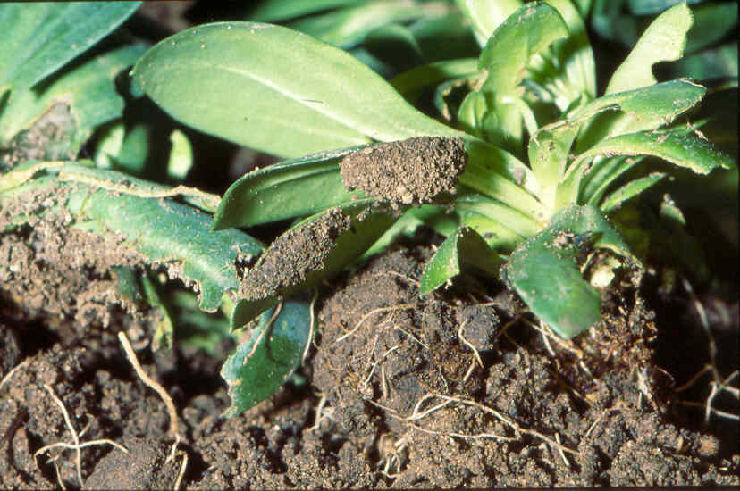
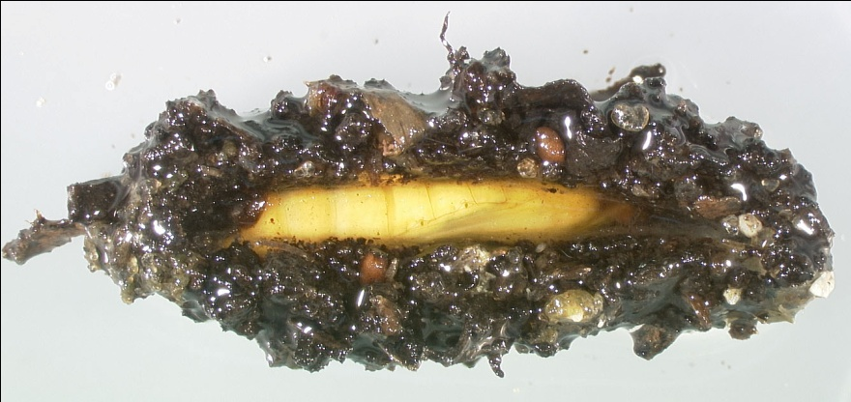
Identification
Pupae
9-12mm long
Yellow-brown in color
Gets darker closer to emergence time
Makes a cocoon of webbing with soil and frass in it
Found on undersides of leaves, at the edge of the pot, or in the upper soil layer
Image credits:
top image - Henk Stigter, Plant Protection Service, National Reference Centre, The Netherlands
middle image - Carmelo Peter Bonsignore, Università degli Studi Mediterranei di Reggio Calabria
bottom image- James Hayden, Florida Department of Agriculture and Consumer Services, Division of Plant Industry
Notes:
The pupae undergo pupation in a cocoon made of webbing, frass, and soil particles. The cocoon measures 15 to 19mm (0.6 to 0.75in). The pupae itself is yellow brown in color (becoming darker as the adult gets closer to emergence) and measures 9 to 12mm long (0.35 to 0.5in).
Information sources:
Anonymous. 2005b. Plant Pest Information: Duponchelia fovealis Zeller. Canadian Food Inspection Agency.
Accessed 4/29/2011 –
http://entnemdept.ufl.edu/pestalert/Duponchelia_fovealis_Canada.pdf
Bethke, James and Brian Vander Mey. 2010. Pest Alert: Duponchelia fovealis. University of California Cooperative Extension, San Diego.
Accessed 4/29/2011 –
http://cesandiego.ucdavis.edu/files/82188.pdf
Bonsignore, Carmelo Peter and Vincenzo Vacante. 2010. “Duponchelia fovealis (Zeller). A New Emergency for Strawberries?”. Protezione delle colture, pp. 40-43.
Brambila, Julieta and Ian Stocks. 2010. The European Pepper Moth, Duponchelia fovealis Zeller (Lepidoptera: Crambidae), a Mediterranean Pest Moth Discovered in Central Florida.
Accessed 4/29/2011 -
http://www.freshfromflorida.com/pi/pest_alerts/pdf/duponchelia_fovealis.pdf
CABI International. 2010. “Selected Sections for: Duponchelia fovealis (Southern European Marshland Pyralid)”. Crop Protection Compendium.
Guda, C. D. , A. Capizzi, and P. Trematerra. 1988. “Damages on Eustoma grandiflorum (Raf.) Shinn. Caused by Duponchelia fovealis (Zeller)”. Annali dell’Istituto Sperimentale per la Floricultura. Vol. 19, pp. 3-11.
Hoffman, Kevin. 2010. CDFA Detection Advisory for a Cramid moth: Duponchelia fovealis (Zeller) (Pyraloidea: Crambidae). Reference PDR: 1511851.
Accessed 4/29/2011 –
http://www.kernag.com/dept/news/2010/2010-san-diego-duponchelia-fovealis-07-16-2010.pdf.
Trematerra, P. 1990. “Morphological aspects of Duponchelia fovealis Zeller (Lepidoptera: Pyralidae)”. Redia, vol. 73, issue 1, pp. 41-52.

Slide 8
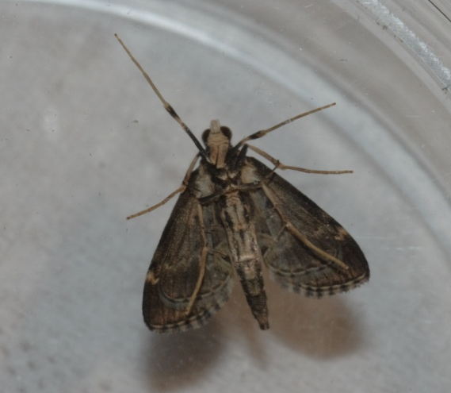
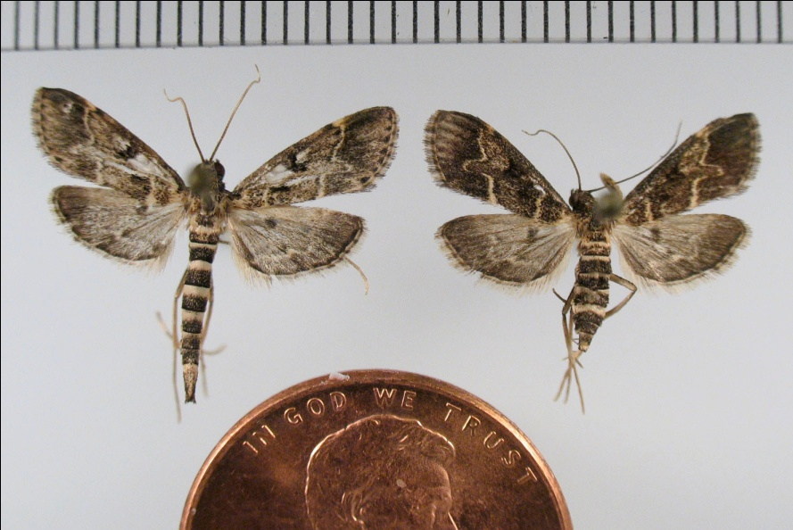
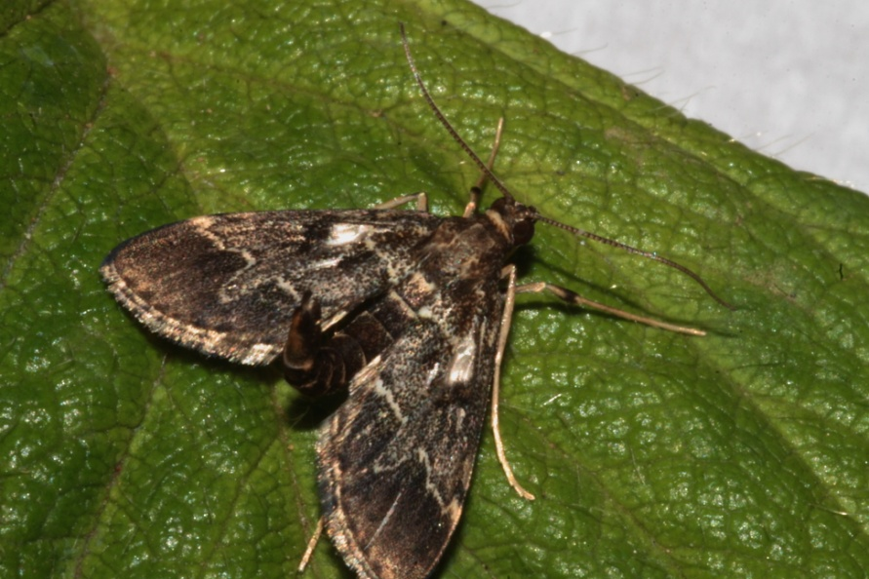
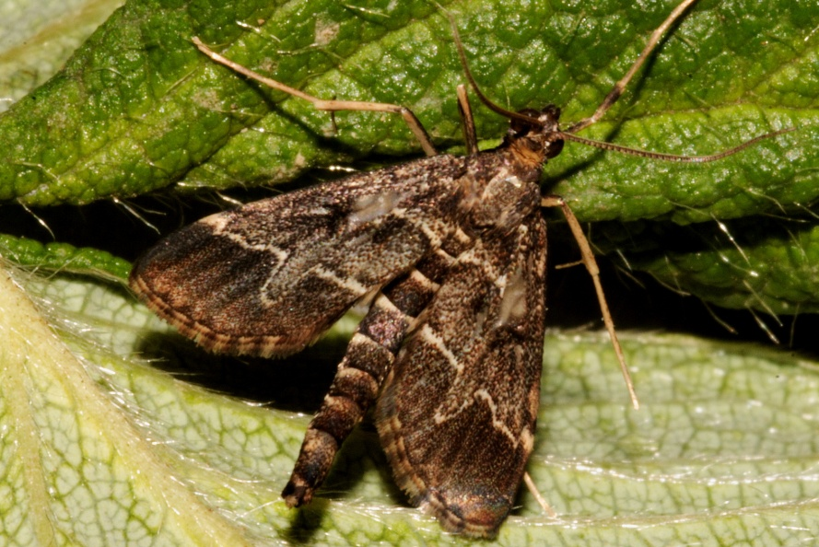
Identification
Adults
male
female
Image credits:
top right - James Hayden, Florida Department of Agriculture and Consumer Services, Division of Plant Industry
all others - Carmelo Peter Bonsignore, Università degli Studi Mediterranei di Reggio Calabria
Notes:
Adults have a wingspan of 19 to 21mm (0.75 to 0.83in). The forewings (measuring 9 to 11mm or 0.35 to 0.43in) are gray-brown in color with 2 yellowish white transverse lines (red arrows). The outermost of these lines has a pronounced “finger” that points towards the edge of the wing (yellow arrow). When at rest, the wings are held out from body forming a triangle. The wing fringe is cream-colored alternating with dark (orange arrows). The adult body measures 9 to 12mm (0.35 to 0.5in) in length. The head, antennae, and body are olive brown. The abdomen has cream colored rings encircling it (purple arrow). The legs are pale brown.
The males’ abdomen is held curved upwards (almost 90 degrees from horizontal – blue arrow). Males have a longer, slimmer abdomen compared to females (green arrows). In fact, the abdomen of the male is unusually long for most moths as it extends beyond the wings. The males also have a cream colored somewhat triangular shaped spot located along the innermost line of the forewing (white and black arrows). In some cases, this area looks like a clear area in the wing (fovea). This area may be seen when the males are at rest, though probably the use of a hand lens is needed. In addition, if the male specimen has lost many of its scales, you may not be able to see this area at all. You may even have a hard time seeing the finger protection on the outermost line if the specimen has lost many wing scales.
The hindwings cannot be seen unless the specimen is spread (top right image). When they are, you will see that the hindwings of both sexes are pale-olive brown with a cream colored wavy line going across the middle of the wing (pink arrows).
It has been noted in a few articles that the adults (presumably both males and females) fly low and fast with their abdomen curved upwards which gives the species a unique flight pattern (rather quick and irregular in movement). In addition, it has been noted that with heavy infestations, the adults can move in swarms.
Information sources:
Anonymous. 2005b. Plant Pest Information: Duponchelia fovealis Zeller. Canadian Food Inspection Agency.
Accessed 4/29/2011 –
http://entnemdept.ufl.edu/pestalert/Duponchelia_fovealis_Canada.pdf
Bethke, James and Brian Vander Mey. 2010. Pest Alert: Duponchelia fovealis. University of California Cooperative Extension, San Diego.
Accessed 4/29/2011 –
http://cesandiego.ucdavis.edu/files/82188.pdf
Bonsignore, Carmelo Peter and Vincenzo Vacante. 2010. “Duponchelia fovealis (Zeller). A New Emergency for Strawberries?”. Protezione delle colture, pp. 40-43.
Brambila, Julieta and Ian Stocks. 2010. The European Pepper Moth, Duponchelia fovealis Zeller (Lepidoptera: Crambidae), a Mediterranean Pest Moth Discovered in Central Florida.
Accessed 4/29/2011 -
http://www.freshfromflorida.com/pi/pest_alerts/pdf/duponchelia_fovealis.pdf
CABI International. 2010. “Selected Sections for: Duponchelia fovealis (Southern European Marshland Pyralid)”. Crop Protection Compendium.
Guda, C. D. , A. Capizzi, and P. Trematerra. 1988. “Damages on Eustoma grandiflorum (Raf.) Shinn. Caused by Duponchelia fovealis (Zeller)”. Annali dell’Istituto Sperimentale per la Floricultura. Vol. 19, pp. 3-11.
Hoffman, Kevin. 2010. CDFA Detection Advisory for a Cramid moth: Duponchelia fovealis (Zeller) (Pyraloidea: Crambidae). Reference PDR: 1511851.
Accessed 4/29/2011 –
http://www.kernag.com/dept/news/2010/2010-san-diego-duponchelia-fovealis-07-16-2010.pdf.
Pijnakker, Juliette. 2001. “Duponchelia fovealis, le lépidoptère redouté des plantes en pot aux Pays-Bas”, Revue Horticole, volume 429, pp. 51-53.
Trematerra, P. 1990. “Morphological aspects of Duponchelia fovealis Zeller (Lepidoptera: Pyralidae)”. Redia, vol. 73, issue 1, pp. 41-52.
Unknown. 2006a. “Duponchelia alla ribalta”, Colture Protette, No. 3, page 14.

Slide 9
Life cycle
4-9 days
1-2 weeks
1-2 weeks
3-4 weeks
Image credit:
Carmelo Peter Bonsignore, Università degli Studi Mediterranei di Reggio Calabria
Notes:
The length of development for this pest varies according to temperature. In a greenhouse setting (at 68˚F or 20˚C), the development time is 4-9 days for the eggs; 3-4 weeks for the larvae; 1-2 weeks for pupation; and 1-2 weeks for adults (6-8 weeks in total).
The adults quickly mate with females laying eggs within 24 hours of emergence. The females are capable of laying 200 eggs during her lifetime. In a greenhouse setting, 8 to 9 generations per year have been recorded. In the warm climates of California and the southeastern United States, the potential for multiple brood production and a shortened life cycle is quite high.
Information sources:
Ahern, Robert. 2010. Amended NPAG Report. Duponchelia fovealis Zeller: Lepidoptera/Pyralidae.
Accessed 4/29/2011 -
http://entnemdept.ufl.edu/pestalert/NPAG_duponchelia_report.pdf .
Anonymous. 2005a. Risk management Decision Document for Duponchelia fovealis in Canada. Canadian Food Inspection Agency.
Accessed 4/29/2011 -
http://entnemdept.ufl.edu/pestalert/duponchelia_fovealis_risk_management.pdf
Anonymous. 2005b. Plant Pest Information: Duponchelia fovealis Zeller. Canadian Food Inspection Agency.
Accessed 4/29/2011 –
http://entnemdept.ufl.edu/pestalert/Duponchelia_fovealis_Canada.pdf
Bethke, James and Brian Vander Mey. 2010. Pest Alert: Duponchelia fovealis. University of California Cooperative Extension, San Diego.
Accessed 4/29/2011 –
http://cesandiego.ucdavis.edu/files/82188.pdf
Bonsignore, Carmelo Peter and Vincenzo Vacante. 2010. “Duponchelia fovealis (Zeller). A New Emergency for Strawberries?”. Protezione delle colture, pp. 40-43.
Brambila, Julieta and Ian Stocks. 2010. The European Pepper Moth, Duponchelia fovealis Zeller (Lepidoptera: Crambidae), a Mediterranean Pest Moth Discovered in Central Florida.
Accessed 4/29/2011 -
http://www.freshfromflorida.com/pi/pest_alerts/pdf/duponchelia_fovealis.pdf
CABI International. 2010. “Selected Sections for: Duponchelia fovealis (Southern European Marshland Pyralid)”. Crop Protection Compendium.
Hoffman, Kevin. 2010. CDFA Detection Advisory for a Cramid moth: Duponchelia fovealis (Zeller) (Pyraloidea: Crambidae). Reference PDR: 1511851.
Accessed 4/29/2011 –
http://www.kernag.com/dept/news/2010/2010-san-diego-duponchelia-fovealis-07-16-2010.pdf.
Jackel, Barbara, Birgit Kummer, and Monika Kurhais. 1996. “Biological Control of Duponchelia fovealis Zeller (Lepidoptera, Pyralidae)”. Mitteilungen aus der Biologishen fur Land und Forstwirtschaft. Vol. 321. p. 483.
Pijnakker, Juliette. 2001. “Duponchelia fovealis, le lépidoptère redouté des plantes en pot aux Pays-Bas”, Revue Horticole, volume 429, pp. 51-53.
Romeijn, G. 1996. “Een nieuwe plaag in de kas”, Vakblad voor de Bloemisterij, volume 47, pp. 46-47.
Unknown. 2006a. “Duponchelia alla ribalta”, Colture Protette, No. 3, page 14.

Slide 10
Hibernation and Dispersal
Hibernation and diapause are questionable
In colder climates – it is primarily a pest of greenhouses
In warmer climates – it is usually found in the field
Dispersal
Movement of plant material spreads this pest
They are also good fliers
Notes:
This pest does not seem to be cold tolerant and the literature suggests that this insect does not undergo hibernation or diapause (a period of arrested growth and development in insects). In northern climates, it is mainly a pest of greenhouses (though it may be found outside during warm summer months, dying off when it becomes cold). Based on these observations, in warmer, humid climates, it may be possible to find the species outside in the landscape for longer times. It is worth noting that the lack of observations of hibernation or diapause may only apply to greenhouses that are in continuous operation and for areas such as the Canary Islands where it has been noted that they produce broods continuously due to a fairly constant climate year round.
In an article published in Colture Protette, it notes that the moth can overwinter in the pupal stage. The ability of EPM to overwinter in the pupal stage corresponds with notations describing the presence of adults in parts of its native range from April to May and from August to October producing at least 2 broods a year. The observation that it could hibernate in a pupal stage in areas with less extreme winter temperatures could have a large affect on the level of pest this species could become in the United States.
Adults are good fliers (upwards of 100km or 0.62 miles), but they can also be dispersed through propagative and non-propagative material such as fruit, herbs, fresh vegetable products, and cut flowers due to the fact that they can bore into stems and fruit and are well hidden among the soil and leaves as well as between the container sides and the soil. In one paper, a reference indicates that EPM has been dispersed on Sansevieria (mother-in-laws tongue) and croton (Codiaeum variegatum) through the commercial shipping of these plants though there is nothing in the literature indicating that these plants are actually hosts.
Information sources:
Ahern, Robert. 2010. Amended NPAG Report. Duponchelia fovealis Zeller: Lepidoptera/Pyralidae.
Accessed 4/29/2011 -
http://entnemdept.ufl.edu/pestalert/NPAG_duponchelia_report.pdf .
Anonymous. 2005a. Risk management Decision Document for Duponchelia fovealis in Canada. Canadian Food Inspection Agency.
Accessed 4/29/2011 -
http://entnemdept.ufl.edu/pestalert/duponchelia_fovealis_risk_management.pdf
Anonymous. 2005b. Plant Pest Information: Duponchelia fovealis Zeller. Canadian Food Inspection Agency.
Accessed 4/29/2011 –
http://entnemdept.ufl.edu/pestalert/Duponchelia_fovealis_Canada.pdf
Brambila, Julieta and Ian Stocks. 2010. The European Pepper Moth, Duponchelia fovealis Zeller (Lepidoptera: Crambidae), a Mediterranean Pest Moth Discovered in Central Florida.
Accessed 4/29/2011 -
http://www.freshfromflorida.com/pi/pest_alerts/pdf/duponchelia_fovealis.pdf
CABI International. 2010. “Selected Sections for: Duponchelia fovealis (Southern European Marshland Pyralid)”. Crop Protection Compendium.
Derksen, A., and L. Whilby. 2011. “Update on Florida CAPS trapping activities for Duponchelia fovealis Zeller, September 2010 to May 2011”, CAPS Report.
accessed 8/15/2011 –
http://entomology.ifas.ufl.edu/stocks/DFOV_update%201_v5%2008-19-11.pdf
Faquaet, Marcel. 2000. “Duponchelia fovealis, een nieuwe soort voor de Belgische fauna (Lepidoptera: Pyralidae)”. Phegea 28:1.
Guda, C. D. , A. Capizzi, and P. Trematerra. 1988. “Damages on Eustoma grandiflorum (Raf.) Shinn. Caused by Duponchelia fovealis (Zeller)”. Annali dell’Istituto Sperimentale per la Floricultura. Vol. 19, pp. 3-11.
Hale, W.G. and J.P. Margham. 1991. The Harper Collins Dictionary of Biology. Harper Perennial, New York.
Hoffman, Kevin. 2010. CDFA Detection Advisory for a Cramid moth: Duponchelia fovealis (Zeller) (Pyraloidea: Crambidae). Reference PDR: 1511851.
Accessed 4/29/2011 –
http://www.kernag.com/dept/news/2010/2010-san-diego-duponchelia-fovealis-07-16-2010.pdf.
Marek J. and E. Bártová. 1998. Duponchelia fovealis Zeller, 1847, a new pest of glasshouse plants in the Czech Republic. Plant Protection Science, 34(4):151-152.
Unknown. 2006a. “Duponchelia alla ribalta”, Colture Protette, No. 3, page 14.
Unknown. 2006b. “Duponchelia: capitolo secondo”, Colture Protette, No. 4, page 24.

Slide 11
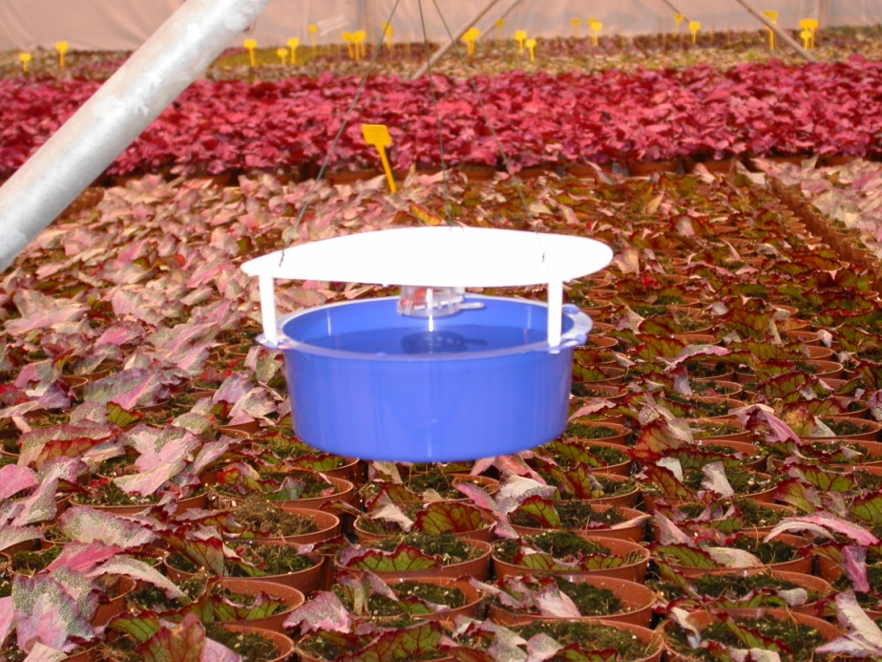
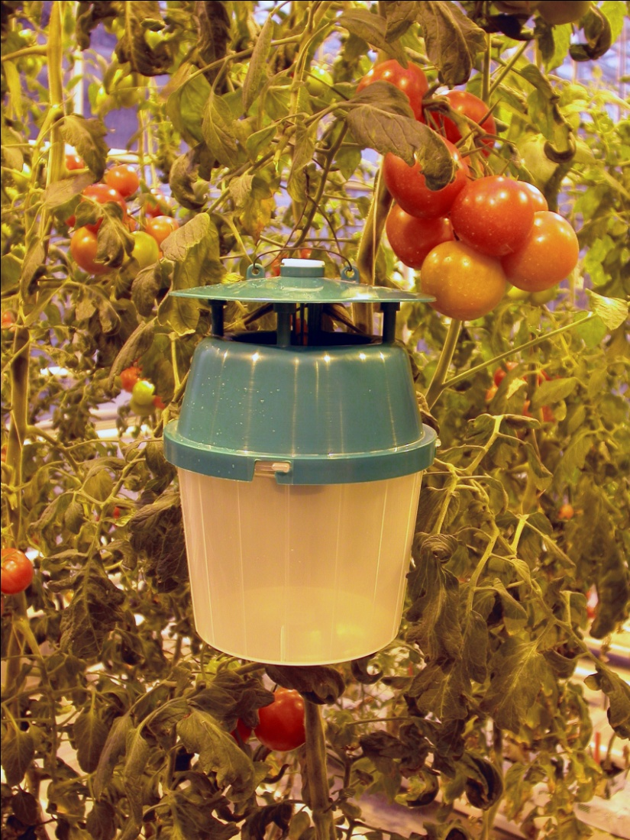
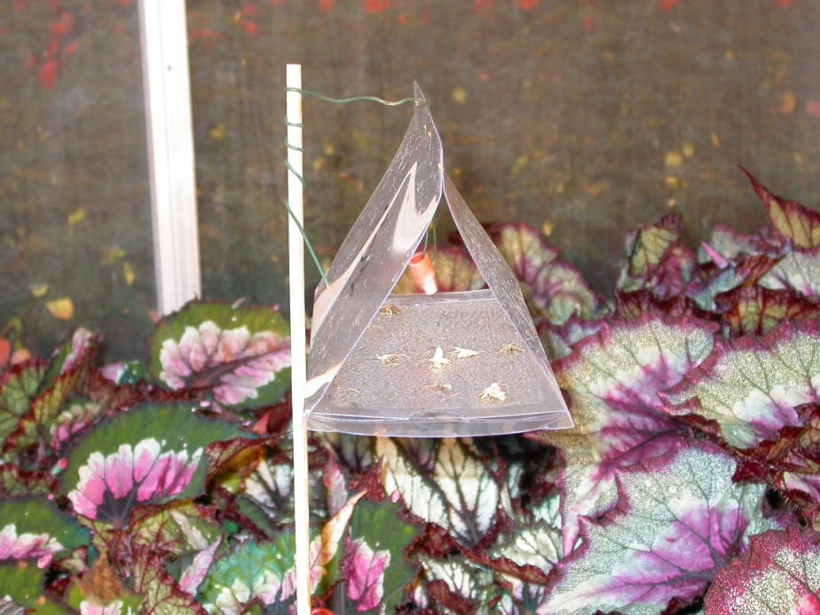
Monitoring
Image credit:
Dr. Peter van Deventer, Plant Research International, Wageningen, The Netherlands
Notes:
Monitoring for this pest will be necessary for controlling its population levels by helping to coordinate biological and chemical control measures. The sex pheromone for this species was identified in 2007 and made commercially available for use in pheromone traps. The use of 1mg of pheromones in a trap will lure males for 4 to 8 weeks. In a study conducted by Deventer, delta traps, water traps, and funnel traps (may also be called bucket traps or even unitraps) were compared for efficacy of monitoring for Duponchelia fovealis in a greenhouse setting.
Water traps seem to be the most effective means of capturing the males of this insect. They provide a larger flat landing surface, have a high trapping capacity, and are easy to maintain (but don’t forget to add the soap). A pheromone lure is used to bring the males to the trap.
Delta traps work well as the adults prefer to land on a flat surface, however, the sticky trap surface rapidly fills with caught insects and dust and needs to be replaced regularly (usually every 20-30 days).
Funnel traps are least effective in capturing this moth (as it has no flat landing surface). Light trapping can also be used to monitor the population. They seem to prefer blue (ultraviolet) light.
In one paper, it was noted that in chrysanthemums that were shade-grown, they monitored for the adults using yellow traps, not pheromone traps and that the adults were often found during the day within the folds of the fabric (around windows).
Trapping can be used to help control population levels; however, 90% of males would need to be trapped to reduce the population of the next generation.
Light trapping (ultraviolet or blue light) can also be used to monitor the population.
Information sources:
Anonymous. 2005a. Risk management Decision Document for Duponchelia fovealis in Canada. Canadian Food Inspection Agency.
Accessed 4/29/2011 -
http://entnemdept.ufl.edu/pestalert/duponchelia_fovealis_risk_management.pdf
Bonsignore, Carmelo Peter and Vincenzo Vacante. 2010. “Duponchelia fovealis (Zeller). A New Emergency for Strawberries?”. Protezione delle colture, pp. 40-43.
Brambila, Julieta and Ian Stocks. 2010. The European Pepper Moth, Duponchelia fovealis Zeller (Lepidoptera: Crambidae), a Mediterranean Pest Moth Discovered in Central Florida.
Accessed 4/29/2011 -
http://www.freshfromflorida.com/pi/pest_alerts/pdf/duponchelia_fovealis.pdf
CABI International. 2010. “Selected Sections for: Duponchelia fovealis (Southern European Marshland Pyralid)”. Crop Protection Compendium.
DeVenter, Peter van. 2009. “Water trap best for catching Duponchelia”. Fruit & Veg Tech 9.1.
Accessed 4/29/2011 -
http://documents.plant.wur.nl/wurglas/C_bestwatertrap.pdf.
Guda, C. D. , A. Capizzi, and P. Trematerra. 1988. “Damages on Eustoma grandiflorum (Raf.) Shinn. Caused by Duponchelia fovealis (Zeller)”. Annali dell’Istituto Sperimentale per la Floricultura. Vol. 19, pp. 3-11.
MacLeod, A. 1996. Summary Pest Risk Assessment: Duponchelia fovealis. DEFRA (Department for Environment, Food, and Rural Affairs), Central Science Laboratory, Sand Hutton, York, United Kingdom.
Pijnakker, Juliette. 2001. “Duponchelia fovealis, le lépidoptère redouté des plantes en pot aux Pays-Bas”, Revue Horticole, volume 429, pp. 51-53.
Romeijn, G. 1996. “Een nieuwe plaag in de kas”, Vakblad voor de Bloemisterij, volume 47, pp. 46-47.
Unknown. 2006b. “Duponchelia: capitolo secondo”, Colture Protette, No. 4, page 24.
Zandigiacimo, Pietro and Filippo Michele Buian. 2007. “Duponchelia fovealis: Un Lepidopterro Crambide Dannoso alle Colture Floricole”. Notiziario ERSA, 20 (2), pp. 3-5.

Slide 12
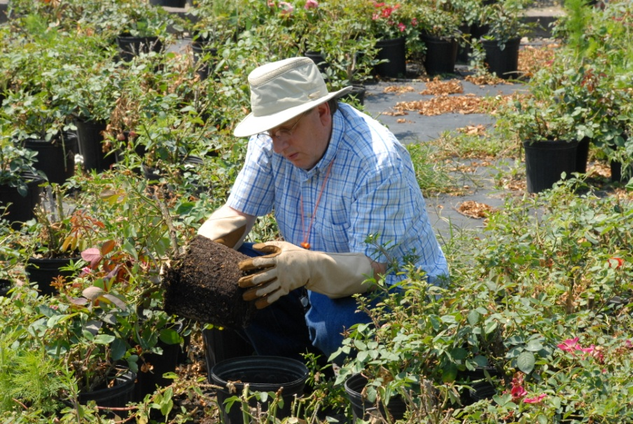
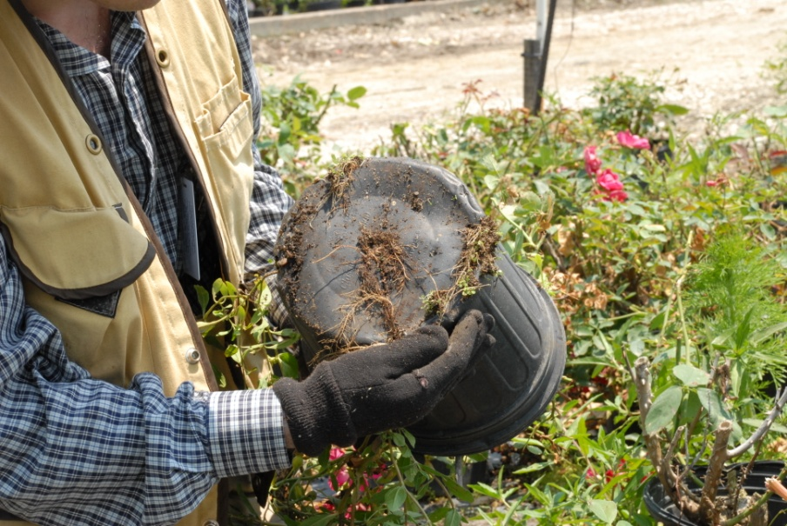
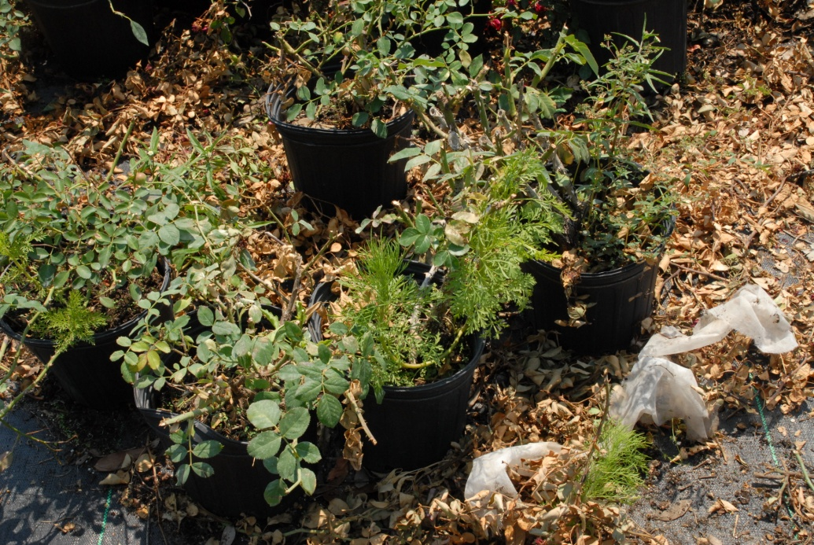
Inspection
Image credits:
Lyle Buss, Department of Entomology and Nematology, University of Florida
Notes:
Inspection for caterpillars is often driven by the presence of damage observed on plants (discussed previously) and/or by observing the presence of the adult moths in the crop, either as a result of the use of pheromone traps or through direct observation.
Look for signs of the caterpillars’ presence such as webbing, leaves spun together to form tunnels (particularly at interface of leaves and soil), all life stages, and frass along with feeding damage, leaf wilting, and stem collapse (from larval tunneling). In addition, be sure to look at the interface between the soil and the leaves and in detritus found around the crop.
In containerized plants, be sure to look around the base of pots and in detritus next to the pots. Cocoons have been found along the bottom edges of the container next to detritus, but can also be found on low lying leaves.
Information sources:
Ahern, Robert. 2010. Amended NPAG Report. Duponchelia fovealis Zeller: Lepidoptera/Pyralidae.
Accessed 4/29/2011 -
http://entnemdept.ufl.edu/pestalert/NPAG_duponchelia_report.pdf .
Anonymous. 2005b. Plant Pest Information: Duponchelia fovealis Zeller. Canadian Food Inspection Agency.
Accessed 4/29/2011 –
http://entnemdept.ufl.edu/pestalert/Duponchelia_fovealis_Canada.pdf
Bonsignore, Carmelo Peter and Vincenzo Vacante. 2010. “Duponchelia fovealis (Zeller). A New Emergency for Strawberries?”. Protezione delle colture, pp. 40-43.
Brambila, Julieta and Ian Stocks. 2010. The European Pepper Moth, Duponchelia fovealis Zeller (Lepidoptera: Crambidae), a Mediterranean Pest Moth Discovered in Central Florida.
Accessed 4/29/2011 –
http://www.freshfromflorida.com/pi/pest_alerts/pdf/duponchelia_fovealis.pdf
Guda, C. D. , A. Capizzi, and P. Trematerra. 1988. “Damages on Eustoma grandiflorum (Raf.) Shinn. Caused by Duponchelia fovealis (Zeller)”. Annali dell’Istituto Sperimentale per la Floricultura. Vol. 19, pp. 3-11.
Romeijn, G. 1996. “Een nieuwe plaag in de kas”, Vakblad voor de Bloemisterij, volume 47, pp. 46-47.

Slide 13
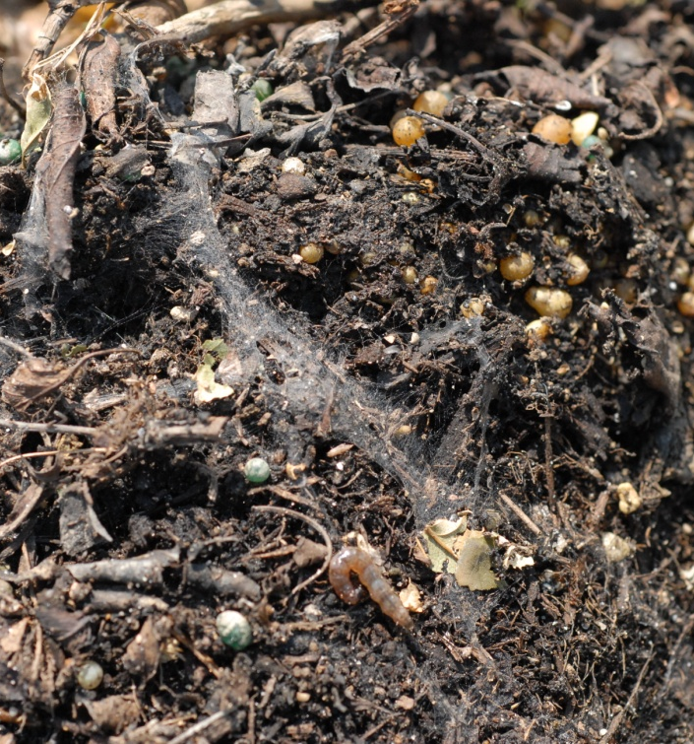
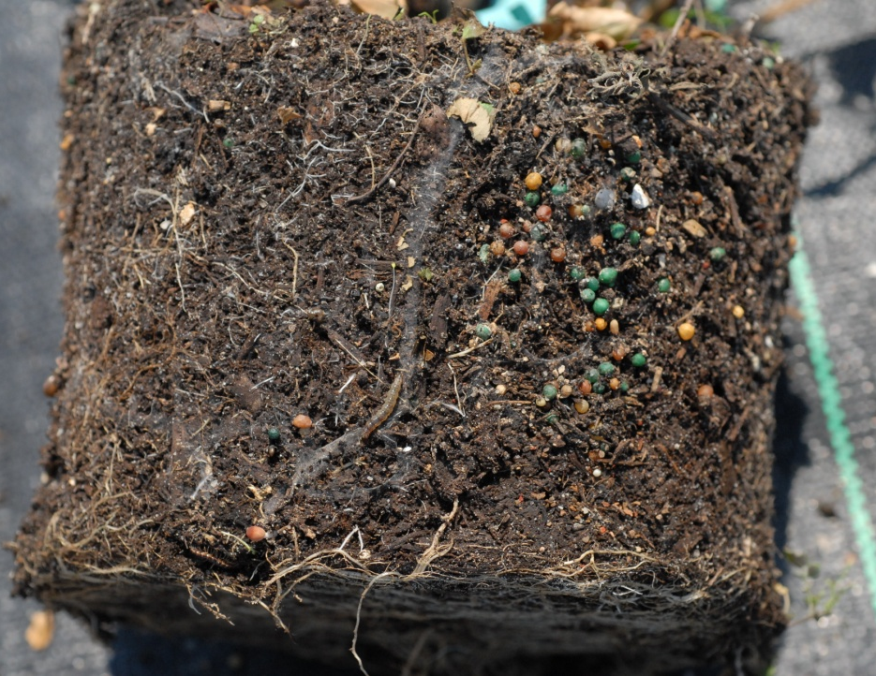
Inspection
Image credits:
Lyle Buss, Department of Entomology and Nematology, University of Florida
Notes:
In containerized plants (especially those that do not have leaves touching the soil), be sure to pull the plant out of the container. The authors and colleagues have found that while there was no evidence of webbing above the soil surface, the silk tunnels and the caterpillars were found at the interface between the soil and the sides of the container.

Slide 14
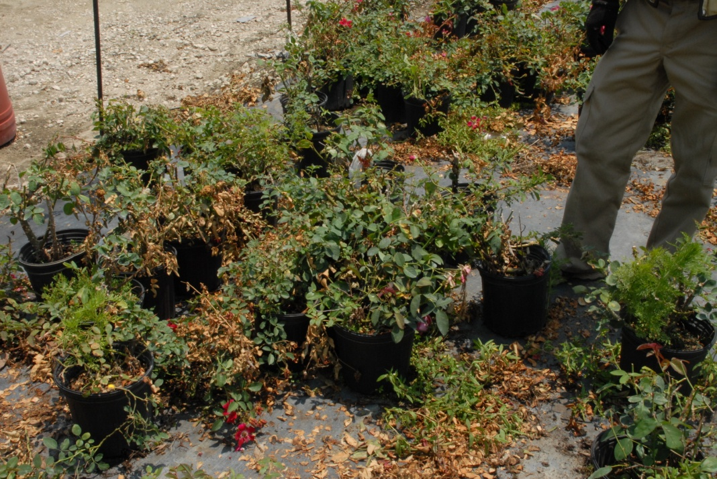
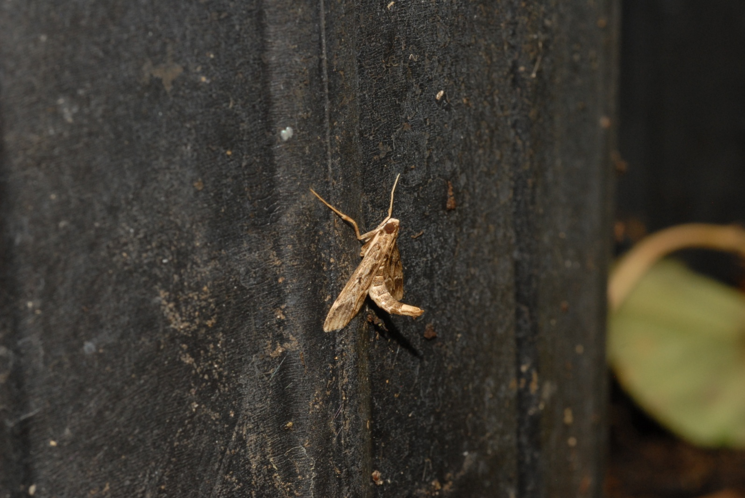
Inspection
Image credits:
Lyle Buss, Department of Entomology and Nematology, University of Florida
Notes:
Adults are nocturnal and like sheltered areas (such as under vegetation) or on the outside of the containers (especially when these containers are grouped together forming a larger sheltered area). When the adults are disturbed, their flight is short and irregular or they can drop to the ground below.
It has been noted in the literature that the detection of the eggs is difficult and requires a certain level of expertise and cost which is not always possible. Sampling of the other life stages is easier and less costly.
Information sources:
Bonsignore, Carmelo Peter and Vincenzo Vacante. 2010. “Duponchelia fovealis (Zeller). A New Emergency for Strawberries?”. Protezione delle colture, pp. 40-43.
Guda, C. D. , A. Capizzi, and P. Trematerra. 1988. “Damages on Eustoma grandiflorum (Raf.) Shinn. Caused by Duponchelia fovealis (Zeller)”. Annali dell’Istituto Sperimentale per la Floricultura. Vol. 19, pp. 3-11.

Slide 15
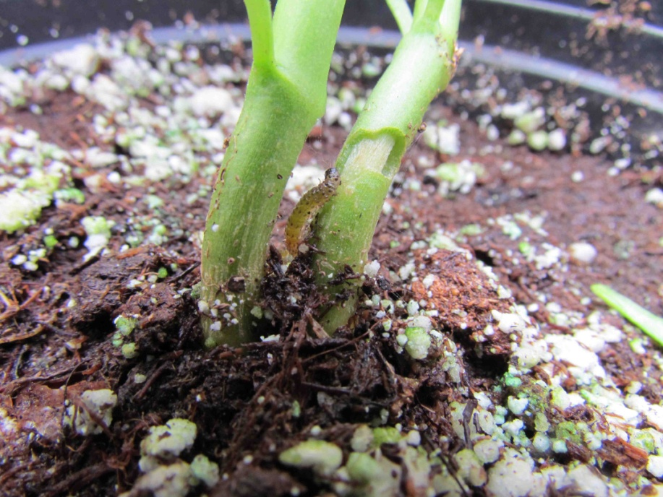
Chemical Control
Targeted spraying may be best
Shape of plants, spacing of plants, and caterpillar behavior determines efficacy of the chemical control
Monitoring populations to determine spraying schedule is also good
Image credits:
Top - Carmelo Peter Bonsignore, Università degli Studi Mediterranei di Reggio Calabria
Bottom - Jim Bethke, Department of Entomology, University of California, Riverside
Notes:
Spinosad, Bifenthrin, Fluvalinate, Deltamethrin, Esfenvalerate, Orthene, and Lambda-cyhalothrin are recommended for treatment according to the literature. In addition, Imidacloprid, Methomyl, Ethoprop, Acephate, Emamectin, Permethrin, Chlorantraniliprole, and Azadirachtin (an extract of Neem Oil) have also been used. These products are reported to kill the insect with varying degrees of success; however, growers need to confirm registration of the use of these products for their specific crop of concern. For example, Teflubenzuron is mentioned in the literature but it is not registered for use in Florida and Chlorpyrifos-methyl is also recommended, however, it is restricted in use as a stored grain insecticide in Florida.
Targeted spraying of the plants may be better than broadly spraying the area due to larval behavior (i.e. burrowing into the stem or fruit, forming webbing tunnels between the leaves and the soil, etc.). Large droplets size is recommended. Contact insecticides are recommended for use before the larvae bore into the stem; after the larvae have bored into the stem however, systemic applications of those chemicals that can be applied through the irrigation water were recommended. Efficacy of contact chemical treatment can also be affected by crop type and the shape of the crop canopy.
In a greenhouse setting, the adults can be treated with an aerosol or fog which should be applied at night to take advantage of their nocturnal activity.
It should be noted that pesticide targets for this pest are either the larvae or the adults. In the field or in a greenhouse, the larvae can be treated with a coarse, wet spray targeting the soil surface and base of the plant. It was recommended to spray contact chemicals in the evening hours.
Be sure to check with your local county extension agent regarding any restrictions on use of these pesticides as some may require an applicator’s license!
Information sources:
Ahern, Robert. 2010. Amended NPAG Report. Duponchelia fovealis Zeller: Lepidoptera/Pyralidae.
Accessed 4/29/2011 -
http://entnemdept.ufl.edu/pestalert/NPAG_duponchelia_report.pdf .Anonymous. 2005. Plant Pest Information: Duponchelia fovealis Zeller. Canadian Food Inspection Agency.
Anonymous. 2005a. Risk management Decision Document for Duponchelia fovealis in Canada. Canadian Food Inspection Agency.
Accessed 4/29/2011 -
http://entnemdept.ufl.edu/pestalert/duponchelia_fovealis_risk_management.pdf
Arzone, A., L. Tavella, and A. Alma. 2002. “Evoluzione dei problemi entomologici delle coltivazioni floricole e florovivaistiche”. Informatore Fitopatologico, 52: 2, pp. 22-31.
Bethke, James and Brian Vander Mey. 2010. Pest Alert: Duponchelia fovealis. University of California Cooperative Extension, San Diego.
Accessed 4/29/2011 –
http://cesandiego.ucdavis.edu/files/82188.pdf
Bonsignore, Carmelo Peter and Vincenzo Vacante. 2010. “Duponchelia fovealis (Zeller). A New Emergency for Strawberries?”. Protezione delle colture, pp. 40-43.
Brambila, Julieta and Ian Stocks. 2010. The European Pepper Moth, Duponchelia fovealis Zeller (Lepidoptera: Crambidae), a Mediterranean Pest Moth Discovered in Central Florida.
Accessed 4/29/2011 –
http://www.freshfromflorida.com/pi/pest_alerts/pdf/duponchelia_fovealis.pdf
CABI International. 2010. “Selected Sections for: Duponchelia fovealis (Southern European Marshland Pyralid)”. Crop Protection Compendium.
Guda, C. D. , A. Capizzi, and P. Trematerra. 1988. “Damages on Eustoma grandiflorum (Raf.) Shinn. Caused by Duponchelia fovealis (Zeller)”. Annali dell’Istituto Sperimentale per la Floricultura. Vol. 19, pp. 3-11.
MacLeod, A. 1996. Summary Pest Risk Assessment: Duponchelia fovealis. DEFRA (Department for Environment, Food, and Rural Affairs), Central Science Laboratory, Sand Hutton, York, United Kingdom.
Pijnakker, Juliette. 2001. “Duponchelia fovealis, le lépidoptère redouté des plantes en pot aux Pays-Bas”, Revue Horticole, volume 429, pp. 51-53.
Romeijn, G. 1996. “Een nieuwe plaag in de kas”, Vakblad voor de Bloemisterij, volume 47, pp. 46-47.
Unknown. 2006b. “Duponchelia: capitolo secondo”, Colture Protette, No. 4, page 24.
Eileen Buss, Department of Entomology and Nematology, University of Florida, personal communication.
More information on the products mentioned above can be found here:
http://npic.orst.edu/factsheets/biftech.pdf
http://npic.orst.edu/factsheets/Deltatech.pdf
http://npic.orst.edu/factsheets/imidacloprid.pdf
http://npic.orst.edu/factsheets/l_cyhalogen.pdf
http://web.pppmb.cals.cornell.edu/resourceguide/mfs/13spinosad.php
http://state.ceris.purdue.edu/doc/fl/statefl.html
http://npic.orst.edu/factsheets/pyrethrins.pdf
http://pmep.cce.cornell.edu/profiles/insect-mite/ddt-famphur/ethoprop/insect-prof-ethoprop.html
http://epa.gov/oppsrrd1/REDs/factsheets/0028fact.pdf
http://npic.orst.edu/factsheets/acephatech.pdf
http://www.epa.gov/opprd001/factsheets/chloran.pdf
http://pmep.cce.cornell.edu/profiles/insect-mite/mevinphos-propargite/pirimiphos-methyl/insect-prof-actellic.html
http://npic.orst.edu/factsheets/Permtech.pdf

Slide 16
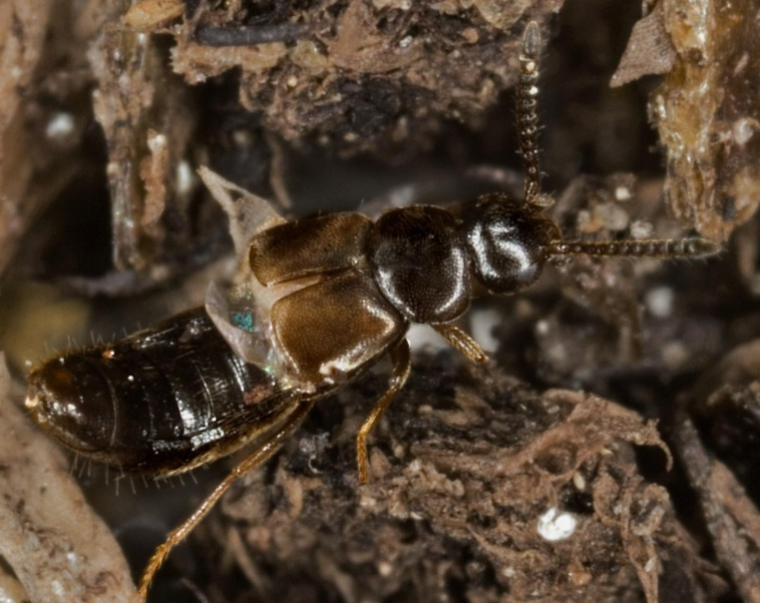
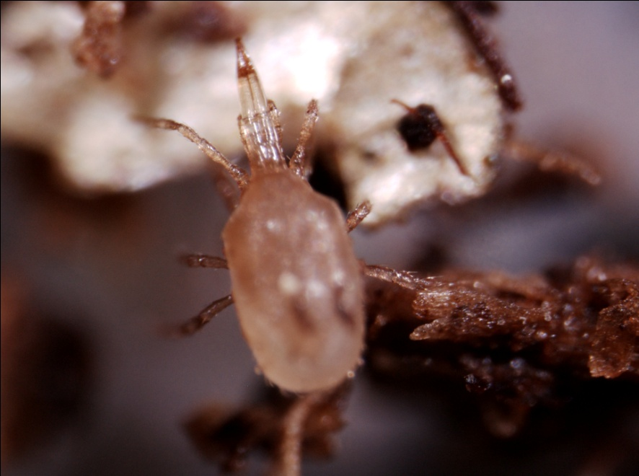
Biological Control
Image credit:
Beetle: David Cappaert, Michigan State University, www.bugwood.org, #5403465
Nematodes: Tesfamariam Mengistu, Department of Entomology and Nematology, University of Florida
Mites: Lance Osborne, Mid-Florida Research and Education Center, University of Florida
Notes:
Biocontrol agents for the larval stage include Bt (which is a formulation of the toxin produced by Bacillus thuringiensis), Heterorhabditis bacteriophora and Steinernema sp. (which are entomopathogenic nematodes), and Dalotia coriaria (which is a beetle - though they are may be listed commercially as Atheta coriaria).
Biocontrol agents for the egg stage includes Stratiolaelaps scimitus (which is a predatory mite that may be listed commercially as Hypoaspis miles), Gaeolaelaps aculeifer (also a predatory mite that may be listed commercially as Hypoaspis aculeifer), Dalotia coriaria and three parasitoid wasps, Trichogramma evanescens, T. cacoeciae, and T. brassicae.
All of these biocontrol agents can be ordered for commercial use. Application recommendations (and methods) vary so be sure to read the label.
The use of Bt has been noted to be quite effective against the larvae if the spores of the bacterium are used in spray formulations (and thus ingested by the larvae). To aid in its effectiveness, the plants should not be in close proximity to each other and the spray must be targeted.
The predatory mites listed above are soil dwellers that also beneficially feed on fungal mites, nematodes, pupae of thrips and leaf miners, and sciarid larvae. The mites are shipped as adults and are shaken from the container onto moistened soil to inoculate it. In a greenhouse setting, they can move between potted plants, but it is best to treat every other plant pot. They will maintain a population as long as there is food to be had. In experimental trials, H. miles (Stratiolaelaps scimitus) had a preference for the upper soil layer compared to the deeper location of H. aculeifer (Gaeolaelaps aculeifer). Also, H. miles more efficiently controlled D. fovealis than H. aculeifer.
Entomopathogenic nematodes (such as Heterorhabditis bacteriophora and Steinemena carpocapsae) were reported to be useful biocontrol in conditions of high humidity and because they could locate concealed larvae. The nematodes can be applied as a liquid mixture (mixed with water) and sprayed on the soil, but can be expensive compared to other biocontrol agents.
The beetle Dalotia coriaria (Atheta coriaria) is also a soil dweller that is effective against eggs and first instar larvae, but not older larvae. It also feeds on larvae of Diptera and thrips pupae which may make it a good biocontrol agent for multiple pests (though they control for different pests than H. miles or H. aculeifer). Unfortunately, it may also feed on beneficial species as well. The adults come in a tube that you shake over the soil. Density of the beetle release depends on the infestation rate.
The species wasps mentioned above (Trichogramma evanescens, T. brassicae, and T. cacoeciae) parasitize the eggs of D. fovealis. According to one study, there was a high parasitism rate that resulted in 100% hatch rate of the parasitoids from the moth eggs.
Information sources:
Ahern, Robert. 2010. Amended NPAG Report. Duponchelia fovealis Zeller: Lepidoptera/Pyralidae.
Accessed 4/29/2011 -
http://entnemdept.ufl.edu/pestalert/NPAG_duponchelia_report.pdf .Anonymous. 2005. Plant Pest Information: Duponchelia fovealis Zeller. Canadian Food Inspection Agency.
Anonymous. 2005a. Risk management Decision Document for Duponchelia fovealis in Canada. Canadian Food Inspection Agency.
Accessed 4/29/2011 -
http://entnemdept.ufl.edu/pestalert/duponchelia_fovealis_risk_management.pdf
Bethke, James and Brian Vander Mey. 2010. Pest Alert: Duponchelia fovealis. University of California Cooperative Extension, San Diego.go.
Accessed 4/29/2011 –
http://cesandiego.ucdavis.edu/files/82188.pdf
Bonsignore, Carmelo Peter and Vincenzo Vacante. 2010. “Duponchelia fovealis (Zeller). A New Emergency for Strawberries?”. Protezione delle colture, pp. 40-43.
Brambila, Julieta and Ian Stocks. 2010. The European Pepper Moth, Duponchelia fovealis Zeller (Lepidoptera: Crambidae), a Mediterranean Pest Moth Discovered in Central Florida.
Accessed 4/29/2011 –
http://www.freshfromflorida.com/pi/pest_alerts/pdf/duponchelia_fovealis.pdf
CABI International. 2010. “Selected Sections for: Duponchelia fovealis (Southern European Marshland Pyralid)”. Crop Protection Compendium.
Jackel, Barbara, Birgit Kummer, and Monika Kurhais. 1996. “Biological Control of Duponchelia fovealis Zeller (Lepidoptera, Pyralidae)”. Mitteilungen aus der Biologishen fur Land und Forstwirtschaft. Vol. 321. p. 483.
MacLeod, A. 1996. Summary Pest Risk Assessment: Duponchelia fovealis. DEFRA (Department for Environment, Food, and Rural Affairs), Central Science Laboratory, Sand Hutton, York, United Kingdom.
Messelink, G. and W. Van Wensveen. 2003. “Biocontrol of Duponchelia fovealis (Lepidoptera: Pyralidae) with Soil-Dwelling Predators in Potted Plants”. Communications in Agriculture and Applied Biological Sciences, Ghent University, 68(4a), pp. 159-165.
Pijnakker, Juliette. 2001. “Duponchelia fovealis, le lépidoptère redouté des plantes en pot aux Pays-Bas”, Revue Horticole, volume 429, pp. 51-53.
Unknown. 2006b. “Duponchelia: capitolo secondo”, Colture Protette, No. 4, page 24.
Zandigiacimo, Pietro and Filippo Michele Buian. 2007. “Duponchelia fovealis: Un Lepidopterro Crambide Dannoso alle Colture Floricole”. Notiziario ERSA, 20 (2), pp. 3-5.
Zimmermann, Olaf. 2004. “Use of Trichogramma wasps in Germany; Present Status of Research and Commercial Application of Egg Parasitoids Against Lepidopterous Pests for Crop” Gesunde Pflanzen 56 (6), pp. 157-166.
http://www.bt.ucsd.edu/what_is_bt.html
http://www.foodsafetynetwork.ca/aspx/public/publication_detail.aspx?id=44
http://www.biconet.com/biocontrol/hypoaspis.html
http://www.biconet.com/biocontrol/nemap.html
http://www.ipm.uconn.edu/ipm/greenhs/htms/biocontrol_fungusgnats.htm

Slide 17
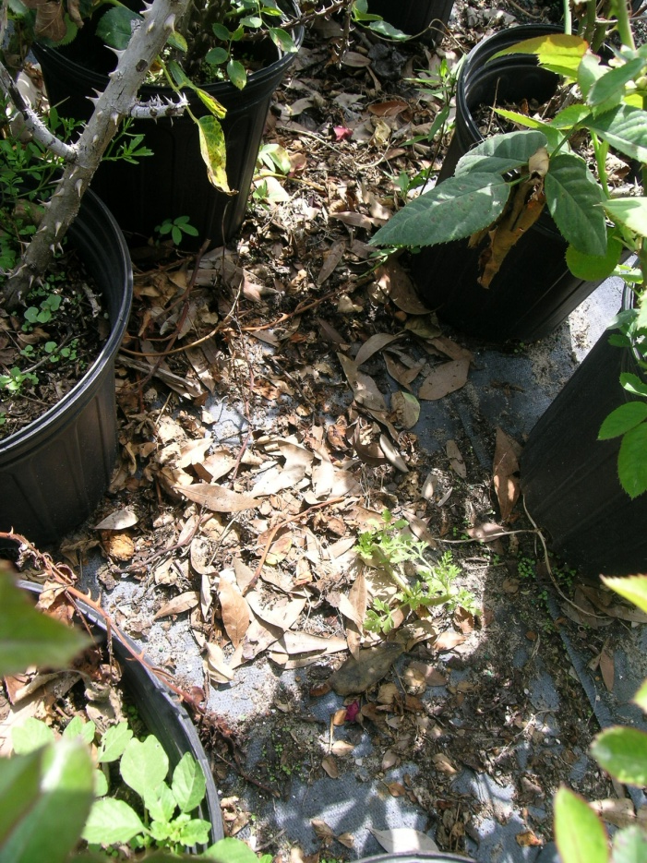
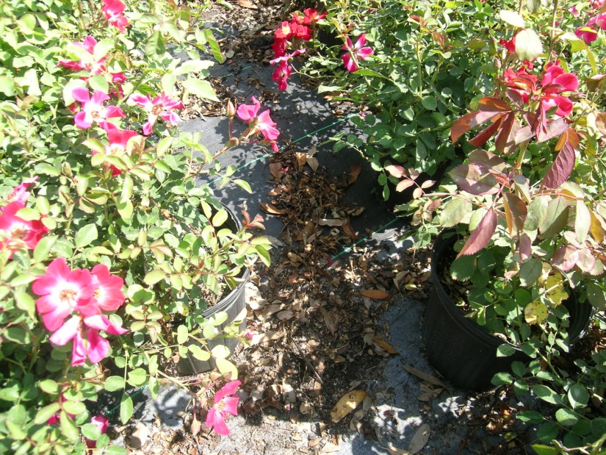
Cultural Control
Removal of plant debris
Removal of lower leaves that come into contact with soil surface
Using drier growth medium
Image credit:
Julieta Brambila, USDA-APHIS-PPQ
Notes:
Because this pest feeds on plant detritus and debris, cultural control includes removal of plant material refuse and weeds from in and around production areas. In addition, because this pest prefers humid, moist microhabitats, removal of the lower leaves of the plant that come into contact with the soil could help. In addition, the use of drier growth medium can control their populations as they like it humid and wet.
Population levels of the biocontrol agents such as the mites and the beetle (discussed previously) are also affected by growth medium (because they live in the soil). For example, in a study by Blok and Messelink, it was found that mixing organic materials with a higher degradation rate (i.e. composts or wood fiber) versus organic material with a lower degradation rate (i.e. peat and coir) into the soil significantly helped maintain a healthy population of the biocontrol agent Hypoaspis miles. The higher degradation rate helped maintain a soil microarthropod population which in turn allowed the mite population to be stable thus increasing the effectiveness of using them as biocontrol agents of Duponchelia fovealis. However, this type of soil mixture seems to work well only for growing plants with a short cultivation period.
If you are in a greenhouse setting, installing insect nets is necessary for the control of not only this pest, but others.
Lastly, searching for the pupae during the winter months (before the adults fly) may be applicable in certain climates.
Information sources:
Anonymous. 2005a. Risk management Decision Document for Duponchelia fovealis in Canada. Canadian Food Inspection Agency.
Accessed 4/29/2011 -
http://entnemdept.ufl.edu/pestalert/duponchelia_fovealis_risk_management.pdf
Blok, C. and G.J. Messelink. 2007. Improving Control of Duponchelia fovealis (Lepidoptera: Pyralidae) by Rooting Media Related Strategies. ISHS Acta Horticulturae 819: International Symposium on Growing Media.
Accessed 4/29/2011 –
http://www.actahort.org/books/819/819_21.htm
Brambila, Julieta and Ian Stocks. 2010. The European Pepper Moth, Duponchelia fovealis Zeller (Lepidoptera: Crambidae), a Mediterranean Pest Moth Discovered in Central Florida.
Accessed 4/29/2011 –
http://www.freshfromflorida.com/pi/pest_alerts/pdf/duponchelia_fovealis.pdf
Unknown. 2006b. “Duponchelia: capitolo secondo”, Colture Protette, No. 4, page 24.
Zandigiacimo, Pietro and Filippo Michele Buian. 2007. “Duponchelia fovealis: Un Lepidopterro Crambide Dannoso alle Colture Floricole”. Notiziario ERSA, 20 (2), pp. 3-5.

Slide 18
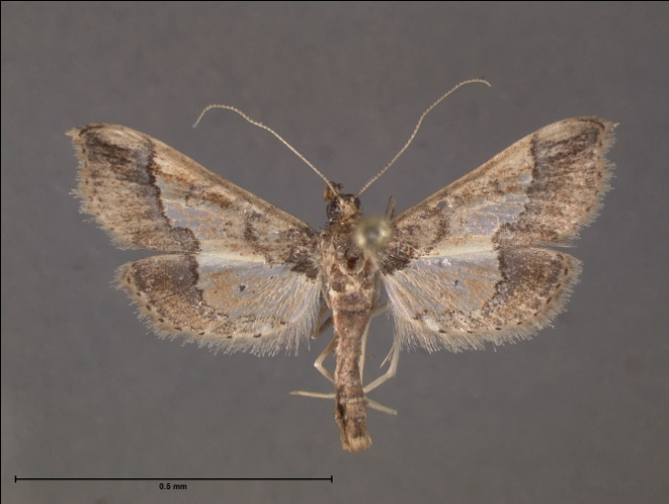
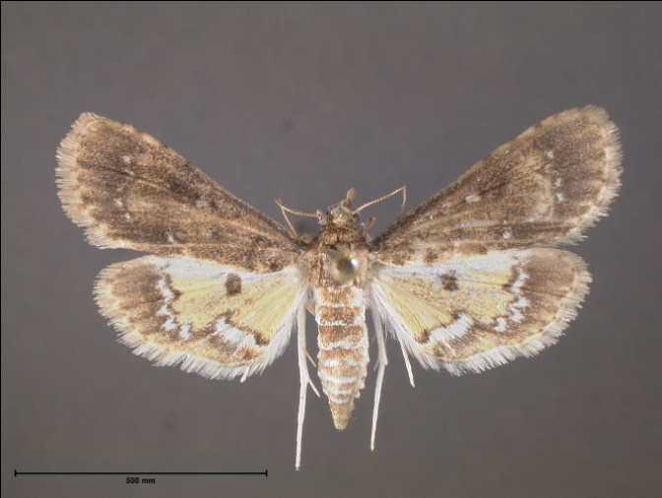
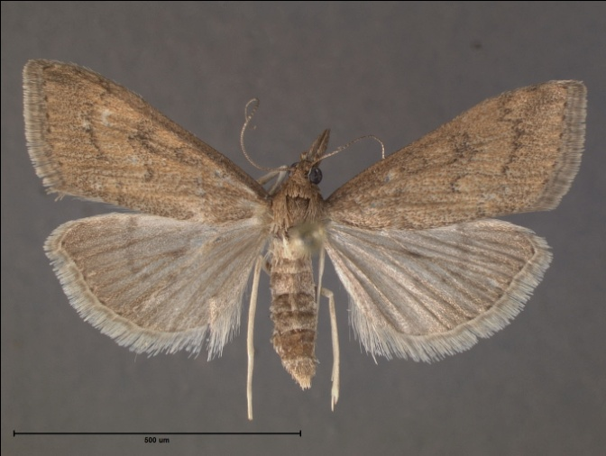
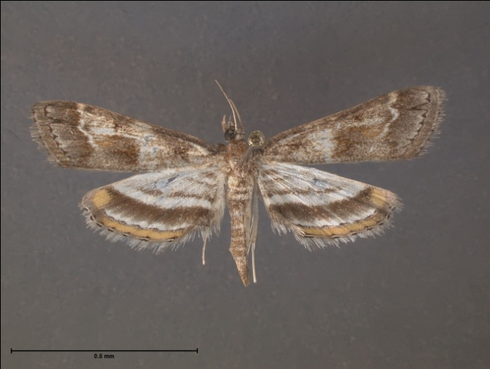
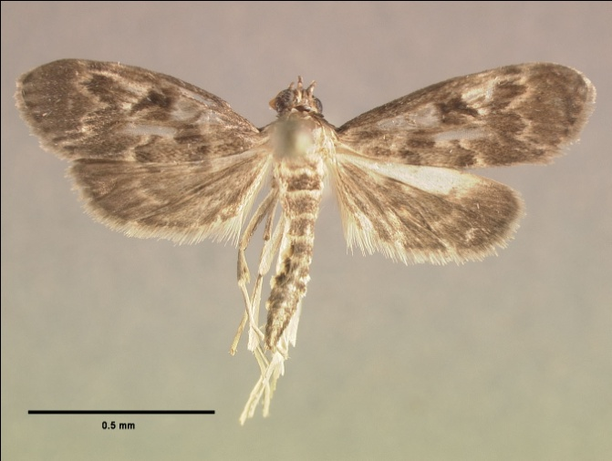
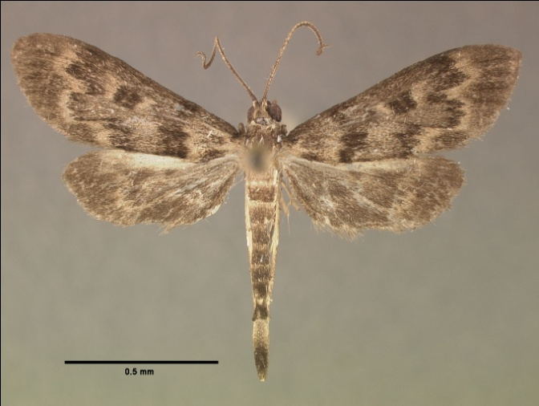
Florida Look Alikes - Adults
Hydriris ornatalis
Niphograpta albiguttalis
Udea rubigalis
Parapoynx obscuralis
Penestola bufalis
Penestola simplicialis
Image credit:
James Hayden, Florida Department of Agriculture and Consumer Services, Division of Plant Industry and
Thomson Paris, graduate student, Department of Entomology and Nematology, University of Florida
Notes:
These moths are similar in appearance to adult Duponchelia fovealis and are fairly common (though if you use a pheromone lure to capture the adults, you should pretty much get only D.fovealis). They include:
Hydriris ornatalis – the ornate hydriris moth
Niphograpta albiguttalis – the water hyacinth moth
Udea rubigalis - the celery leaftier moth
Parapoynx obscuralis – the obscure pondweed moth
Penestola bufalis – the black penestola moth
Penestola simplicialis which doesn’t have a common name.

Slide 19
Regulatory Rules
In partnership with the National Plant Board, APHIS has discussed this pest with experts from affected states and industry and determines that that traditional containment and regulatory approaches may not be practical solutions for European Pepper Moth (EPM) .
EPM Task Force has been established to create a Best Management Practices document.
The official FDACS-DPI response is that although Duponchelia fovealis has been intercepted at several locations throughout Florida in CAPS traps, they have not been detected in the landscape and are therefore considered a pest of limited distribution within the nursery trade.
When it is detected in nurseries, it is considered a pest of quarantine significance.
Notes:
“In partnership with the National Plant Board, APHIS convened discussions with subject matter experts, affected States, and potentially impacted industries, and has concluded that traditional containment and regulatory approaches may not be practical solutions for EPM. This determination is based on the wide distribution and current host range of EPM, which includes peppers, pomegranates, aquatic plants, bedding plants, and nursery stock.
As an alternative to a regulatory program, APHIS, State cooperators, and industry stakeholders are establishing an ad hoc EPM Task Force to facilitate the development and communication of Pest Management Practices (PMP) in order to prevent or minimize the pest’s potential effects on various industries within American agriculture. The task force will encompass three main groups, including: Industry Leadership (IL), Technical Working Group (TWG), and Interagency Working Group (IWG). IL consists of representatives from potentially-impacted industries, including fruit and vegetables, floriculture, and nursery and is responsible for providing the overall coordination and communication of the PMP. The TWG consists of subject matter experts and specialists from universities, extension service, private industry, Federal, and State agencies, and NGOs and is responsible for providing the technical support for the PMP. The IWG includes federal and state regulatory officials from potentially impacted states to provide operational and logistical support to the task force.”
“Duponchelia fovealis has been intercepted at several locations throughout Florida in CAPS traps. Reproducing Duponchelia fovealis populations have not been detected in the landscape. Therefore, Duponchelia is considered a pest of limited distribution within the nursery trade. When it is detected in nurseries, it is considered a pest of quarantine significance.”
Information sources:
SPRO Letter (http://entomology.ifas.ufl.edu/stocks/spro%20letter.pdf)
Statement from FDACS-DPI emailed to authors.

Slide 20
Author and Publication Dates
Stephanie Stocks, M.S.
Assistant –In, Extension Scientist
Department of Entomology and Nematology, Gainesville
Amanda Hodges, Ph.D.
Assistant Extension Scientist
Department of Entomology and Nematology, Gainesville
September 2011

Slide 21
Reviewers
James Hayden, Ph.D., Curator of Lepidoptera, Florida State Collection of Arthropods, FDACS, Division of Plant Industry
Graeme Murphy, M.S., OMAFRA Greenhouse Floriculture IPM Specialist
Julieta Brambila, M.S., Entomologist, USDA-APHIS-PPQ
Lance Osborne, Ph.D., Mid-Florida Research and Education Center, University of Florida

Slide 22
Special Thanks
Many of the papers used in this publication had to be translated. Special thanks go to all the people who aided in the translations.
Serena Stornaiuolo, Florida Department of Agriculture and Consumer Services, Division of Plant Industry
Verena Lietze, Department of Entomology and Nematology, University of Florida
Theodoor Turlings, Director of the National Center of Competence in Research Plant Survival, Université de Neuchâtel
Renato Inserra, Florida Department of Agriculture and Consumer Services, Division of Plant Industry
Michal Bajdich, Postdoctoral Research Fellow, Materials Theory Group, Oak Ridge National Laboratory
Julio Medal, Department of Entomology and Nematology, University of Florida
Alberto Achilli, Glades Crop Care.
Johanna and Graham White
In addition, many images used in this presentation came from colleagues in Europe.
Carmelo Peter Bonsignore, Università degli Studi Mediterranei di Reggio Calabria
Marja van der Straten, Plant Protection Service, Wageningen, The Netherlands
Henk Stigter, Plant Protection Service, National Reference Centre, The Netherlands
Pasquale Trematerra, University of Molise, Italy.
Peter van Deventer, Plant Research International, Wageningen, The Netherlands

Slide 23
Educational Disclaimer and Citation
This presentation can be used for educational purposes for NON-PROFIT workshops, trainings, etc.
Citation:
Stocks, Stephanie and Amanda Hodges. 2011. A New Emerging Pest in Florida: European Pepper Moth (EPM). Updated September 2011. accessed (add the date) - http://mrec.ifas.ufl.edu/lso/dupon/default.asp.

Slide 24
References
Ahern, R. 2010. Amended NPAG Report. Duponchelia fovealis Zeller: Lepidoptera/Pyralidae. Accessed 4/29/2011 -
http://entnemdept.ufl.edu/pestalert/NPAG_duponchelia_report.pdf
Anonymous. 2005a. Risk management Decision Document for Duponchelia fovealis in Canada. Canadian Food Inspection Agency. Accessed 4/29/2011
http://entnemdept.ufl.edu/pestalert/duponchelia_fovealis_risk_management.pdf
Anonymous. 2005b. Plant Pest Information: Duponchelia fovealis Zeller. Canadian Food Inspection Agency. Accessed 4/29/2011 -
http://entnemdept.ufl.edu/pestalert/Duponchelia_fovealis_Canada.pdf
Arzone, A., L. Tavella, and A. Alma. 2002. “Evoluzione dei problemi entomologici delle coltivazioni floricole e florovivaistiche”. Informatore Fitopatologico, 52: 2, pp. 22-31.
Bethke, J. and B. Vander Mey. Pest Alert: Duponchelia fovealis. University of California Cooperative Extension, San Diego. Accessed 4/29/2011
http://cesandiego.ucdavis.edu/files/82188.pdf

Slide 25
References
Billen W. 1994. On the harmfulness of Duponchelia fovealis (Zeller, 1847) in Germany (Lepidoptera, Pyralidae). Nota Lepidopterol, 16: 3-4, p. 212.
Blok, C. and G.J. Messelink. 2007. Improving Control of Duponchelia fovealis (Lepidoptera: Pyralidae) by Rooting Media Related Strategies. ISHS Acta Horticulturae 819: International Symposium on Growing Media. Accessed 4/29/2011 –
http://www.actahort.org/books/819/819_21.htm
Bonsignore, C. P. and V. Vacante. 2010. “Duponchelia fovealis (Zeller). A New Emergency for Strawberries?”. Protezione delle colture, pp. 40-43.
Brambila, J. and I. Stocks. 2010. The European Pepper Moth, Duponchelia fovealis Zeller (Lepidoptera: Crambidae), a Mediterranean Pest Moth Discovered in Central Florida. Accessed 4/29/2011 –
http://www.freshfromflorida.com/pi/pest_alerts/pdf/duponchelia_fovealis.pdf
CABI International. 2010. “Selected Sections for: Duponchelia fovealis (Southern European Marshland Pyralid)”. Crop Protection Compendium.

Slide 26
References
Clark, J. S. 2000. Duponchelia fovealis (Zell.) arriving on imported plant material. Atropos 10:20–21.
Derksen, A., and L. Whilby. 2011. “Update on Florida CAPS trapping activities for Duponchelia fovealis Zeller, September 2010 to May 2011”, CAPS Report.
http://entomology.ifas.ufl.edu/stocks/DFOV_update%201_v5%2008-19-11.pdf
DeVenter, P. van. 2009. “Water trap best for catching Duponchelia”. Fruit & Veg Tech 9.1. Accessed 4/29/2011 -
http://documents.plant.wur.nl/wurglas/C_bestwatertrap.pdf.
Faquaet, M. 2000. “Duponchelia fovealis, een nieuwe soort voor de Belgische fauna (Lepidoptera: Pyralidae)”. Phegea 28:1.
Guda, C. D. , A. Capizzi, and P. Trematerra. 1988. “Damages on Eustoma grandiflorum (Raf.) Shinn. caused by Duponchelia fovealis (Zeller)”. Annali dell’Istituto Sperimentale per la Floricultura. Vol. 19, pp. 3-11.
Hale, W.G. and J.P. Margham. 1991. The Harper Collins Dictionary of Biology. Harper Perennial, New York.

Slide 27
References
Hoffman, Kevin. 2010. CDFA Detection Advisory for a Cramid moth: Duponchelia fovealis (Zeller) (Pyraloidea: Crambidae). Reference PDR: 1511851. Accessed 4/29/2011
http://www.kernag.com/dept/news/2010/2010-san-diego-duponchelia-fovealis-07-16-2010.pdf
Jackel, B., B. Kummer, and M. Kurhais. 1996. “Biological Control of Duponchelia fovealis Zeller (Lepidoptera, Pyralidae)”. Mitteilungen aus der Biologishen fur Land und Forstwirtschaft. Vol. 321. p. 483.
MacLeod, A. 1996. Summary Pest Risk Assessment: Duponchelia fovealis. DEFRA (Department for Environment, Food, and Rural Affairs), Central Science Laboratory, Sand Hutton, York, United Kingdom.
Marek J. and E. Bártová. 1998. Duponchelia fovealis Zeller, 1847, a new pest of glasshouse plants in the Czech Republic. Plant Protection Science, 34(4):151-152.

Slide 28
References
Messelink, G. and W. Van Wensveen. 2003. “Biocontrol of Duponchelia fovealis (Lepidoptera: Pyralidae) with Soil-Dwelling Predators in Potted Plants”. Communications in Agriculture and Applied Biological Sciences, Ghent University, 68(4a), pp. 159-165., pp. 159-165.
Murphy, G. 2005. Duponchelia fovealis - pronouncing it is just the start of the battle. Accessed 4-29-2011 –
http://www.omafra.gov.on.ca/english/crops/hort/news/grower/2005/08gn05a1.htm
NAPPO – Phytosanitary alert system. 2010.
http://www.pestalert.org/oprDetail.cfm?oprID=466&keyword=Duponchelia%20fovealis
Pijnakker, J. 2001. “Duponchelia fovealis, le lépidoptère redouté des plantes en pot aux Pays-Bas”, Revue Horticole, volume 429, pp. 51-53.
Romeijn, G. 1996. “Een nieuwe plaag in de kas”, Vakblad voor de Bloemisterij, volume 47, pp. 46-47.
Trematerra, P. 1990. “Morphological aspects of Duponchelia fovealis Zeller (Lepidoptera: Pyralidae)”. Redia, vol. 73, issue 1, pp. 41-52.

Slide 29
References
Unknown. 2006a. “Duponchelia alla ribalta”, Colture Protette, No. 3, page 14.
Unknown. 2006b. “Duponchelia: capitolo secondo”, Colture Protette, No. 4, page 24.
Zandigiacimo, P. and F. M. Buian. 2007. “Duponchelia fovealis: Un Lepidopterro Crambide Dannoso alle Colture Floricole”. Notiziario ERSA, 20 (2), pp. 3-5.
Zimmermann, O. 2004. “Use of Trichogramma wasps in Germany; Present Status of Research and Commercial Application of Egg Parasitoids Against Lepidopterous Pests for Crop” Gesunde Pflanzen 56 (6), pp. 157-166.
http://www.bt.ucsd.edu/what_is_bt.html
http://www.foodsafetynetwork.ca/aspx/public/publication_detail.aspx?id=44
http://www.biconet.com/biocontrol/hypoaspis.html
http://www.biconet.com/biocontrol/nemap.html
http://www.ipm.uconn.edu/ipm/greenhs/htms/biocontrol_fungusgnats.htm

Slide 30
References
http://npic.orst.edu/factsheets/biftech.pdf
http://npic.orst.edu/factsheets/Deltatech.pdf
http://npic.orst.edu/factsheets/imidacloprid.pdf
http://npic.orst.edu/factsheets/l_cyhalogen.pdf
http://web.pppmb.cals.cornell.edu/resourceguide/mfs/13spinosad.php
http://state.ceris.purdue.edu/doc/fl/statefl.html
http://npic.orst.edu/factsheets/pyrethrins.pdf
http://pmep.cce.cornell.edu/profiles/insect-mite/ddt-famphur/ethoprop/insect-prof-ethoprop.html
http://epa.gov/oppsrrd1/REDs/factsheets/0028fact.pdf
http://npic.orst.edu/factsheets/acephatech.pdf
http://www.epa.gov/opprd001/factsheets/chloran.pdf
http://pmep.cce.cornell.edu/profiles/insect-mite/mevinphos-propargite/pirimiphos-methyl/insect-prof-actellic.html
http://npic.orst.edu/factsheets/Permtech.pdf

